Slide 1
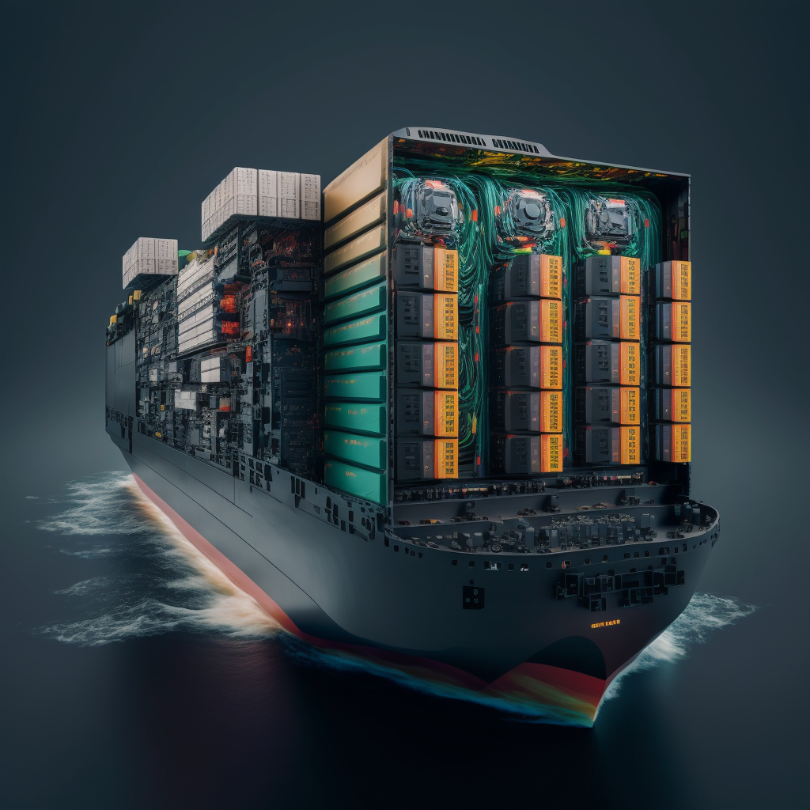
Containerized Mainframe code with Dapr, OpenTelemetry, Datadog and GKE
Dapr Community Call Demo Isaac Johnson

Slide 2
Isaac Johnson
Passions:
Dapr.io
OpenTelemetry
Kubernetes
Azure
Presenting
Camping Hiking and Fishing with my Daughters
Principal SRE Architect at Wellsky
20 years experience in SCM, DevOps and SRE
Lived in Minnesota and San Diego
Active Blogger

Slide 3
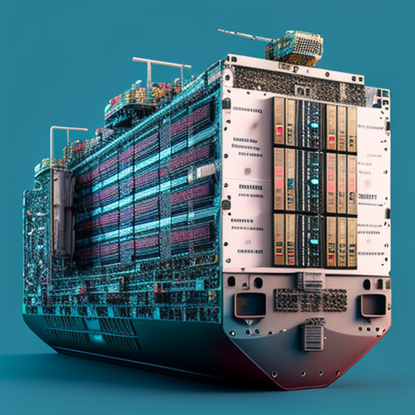
Goals in Containerizing Mainframe Code
Eliminate risk on outdated/difficult to maintain hardware
Easily update code in a testable way
Leverage the scalability (horizontal and vertical) of cloud resources
Leverage Strangler pattern on legacy Monolith system

Slide 4
Focus of Demo
Dapr Calculator App as it shows interconnected services
Containerize a component (add) to use COBOL
Deploy into a local on-prem cluster with Dapr
Orchestrate with front-end
Show Dapr's ability to capture trace data and send to Open Telemetry
Pull it together in a full CICD to On-Prem K3s and GCP

Slide 5
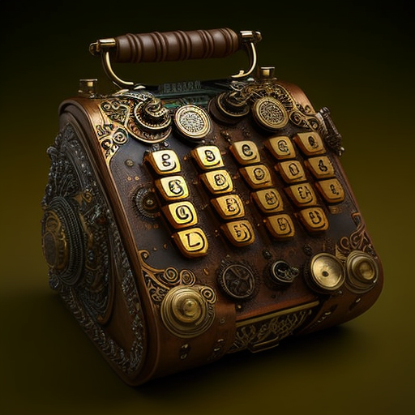
Creating the Add App

Slide 6
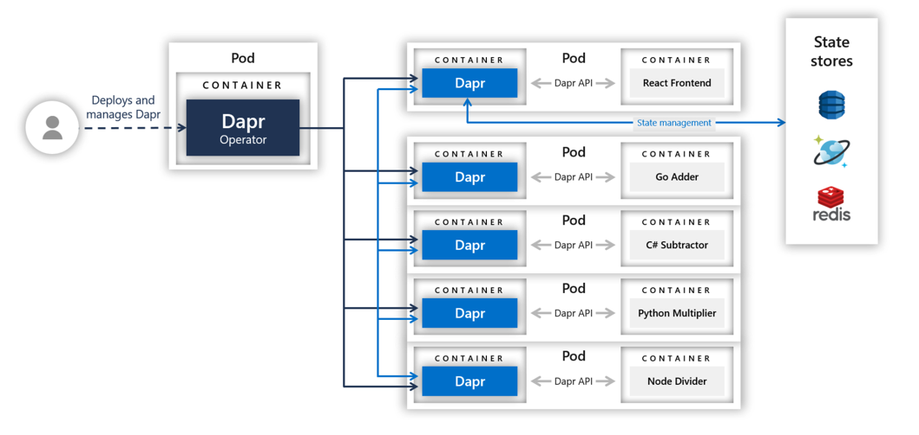
Where and Why
We will update one function, the "Add" container. Arguably this would work with any calculation function written in COBOL
COBOL Adder

Slide 7
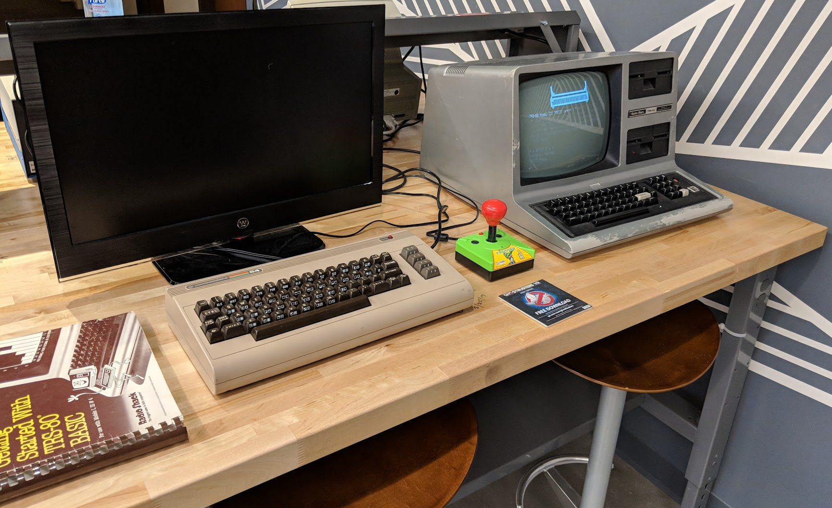
Developing COBOL
Setting up our Development Environment using Docker (or Pacman)

Slide 8
Use NodeJS with Express to invoke
Create a Hello World COBOL app (see myFirstCob.cob below)
bash-5.2$ nvm list
-> v14.19.0
v16.13.2
v16.18.1
bash-5.2$ npm init
This utility will walk you through creating a package.json file.
It only covers the most common items, and tries to guess sensible defaults.
See `npm help init` for definitive documentation on these fields
and exactly what they do.
Use `npm install <pkg>` afterwards to install a package and
save it as a dependency in the package.json file.
Press ^C at any time to quit.
package name: (cobol) cobol_demo
version: (1.0.0)
description: Basic RESTful wrapper
entry point: (index.js) server.js
test command:
git repository:
keywords: Fotran, COBOL, Dapr
author: Isaac Johnson
license: (ISC) MIT
About to write to /Users/isaac.johnson/Workspaces/COBOL/package.json:
bash-5.2$ npm install express --save
npm notice created a lockfile as package-lock.json. You should commit this file.
npm WARN cobol_demo@1.0.0 No repository field.
+ express@4.18.2
….
IDENTIFICATION DIVISION.
PROGRAM-ID. SAMPLE-01.
ENVIRONMENT DIVISION.
DATA DIVISION.
PROCEDURE DIVISION.
MAIN.
DISPLAY "My First COBOL" UPON CONSOLE.
STOP RUN.

Slide 9
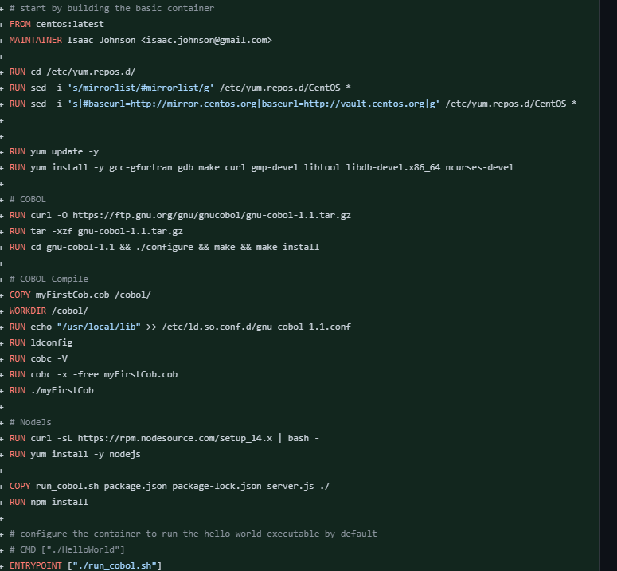
Dockerfile
builds COBOL Executable inline
use a shell to invoke NodeJS

Slide 10
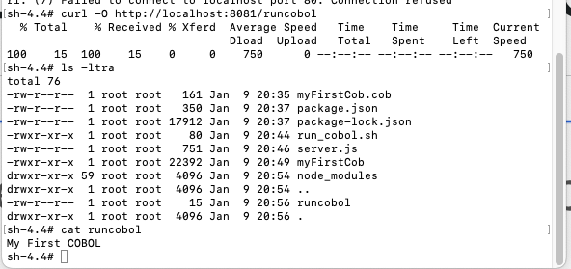
Testing Simple COBOL
PRO-TIP: ChatGPT can help on old languages!
Simple invocation using express with a test
var express = require('express');
var app = express();
var fs = require("fs");
const { exec } = require("child_process");
app.get('/runcobol', function (req, res) {
exec("./myFirstCob", (error, stdout, stderr) => {
if (error) {
console.log(`error: ${error.message}`);
res.end( `error: ${error.message}` );
}
if (stderr) {
console.log(`stderr: ${stderr}`);
res.end( `error: ${stderr}` );
}
console.log(`stdout: ${stdout}`);
res.end( `${stdout}` );
});
})
var server = app.listen(8081, function () {
var host = server.address().address
var port = server.address().port
console.log("Example app listening at http://%s:%s", host, port)
})
Notes:
http://www.pgrocer.net/Cis51/asgn1X07.html
https://www.mainframestechhelp.com/tutorials/cobol/add-statement.htm
https://craftofcoding.wordpress.com/2021/01/26/coding-cobol-reading-a-file-of-integers/

Slide 11
Final COBOL code for add
IDENTIFICATION DIVISION. PROGRAM-ID. ADD-NUMBERS.
ENVIRONMENT DIVISION. INPUT-OUTPUT SECTION. FILE-CONTROL. SELECT INPUT-FILE ASSIGN TO "input.txt" ORGANIZATION IS LINE SEQUENTIAL. SELECT OUTPUT-FILE ASSIGN TO "output.txt" ORGANIZATION IS LINE SEQUENTIAL.
DATA DIVISION. FILE SECTION. FD INPUT-FILE. 01 INPUT-RECORD. 05 INPUT-REAL-DP PIC 9(36). FD OUTPUT-FILE. 01 OUTPUT-RECORD. 05 OUTPUT-NUMBER PIC 9(36).
WORKING-STORAGE SECTION. 01 TOTAL PIC 9(36). 01 END-OF-FILE PIC X(3) VALUE 'FLS'.
PROCEDURE DIVISION. OPEN INPUT INPUT-FILE OPEN OUTPUT OUTPUT-FILE READ INPUT-FILE AT END MOVE 'TRU' TO END-OF-FILE NOT AT END ADD INPUT-REAL-DP TO TOTAL END-READ PERFORM UNTIL END-OF-FILE = "TRU" READ INPUT-FILE AT END MOVE 'TRU' TO END-OF-FILE NOT AT END ADD INPUT-REAL-DP TO TOTAL END-READ END-PERFORM MOVE TOTAL TO OUTPUT-NUMBER WRITE OUTPUT-RECORD CLOSE INPUT-FILE, OUTPUT-FILE STOP RUN.
Known Limitation: decimal and negatives
Notes:
PIC S9(18)V(8)

Slide 12
server.js
fs.writeFileSync("input.txt",operandOne.toString() + '\n');
fs.appendFileSync("input.txt",operandTwo.toString());
console.log(`wrote to input.txt`);
exec("./cobolApp", (error, stdout, stderr) => {
if (error) {
console.log(`error: ${error.message}`);
res.end( `error: ${error.message}` );
}
if (stderr) {
console.log(`stderr: ${stderr}`);
res.end( `error: ${stderr}` );
}
console.log(`stdout: ${stdout}`);
fs.readFile( __dirname + "/" + "output.txt", 'utf8', function (err, data) {
console.log(`got output.txt`);
console.log( data.toString() );
// trim preceeding 0s
res.send(data.toString().replace(regex, ''));
});
});
});
app.listen(port, () => console.log(`Listening on port ${port}!`));
const express = require('express');
const bodyParser = require('body-parser');
const app = express();
app.use(bodyParser.json());
const cors = require('cors');
const port = process.env.APP_PORT ?? '4000';
var fs = require("fs");
const { exec } = require("child_process");
app.use(cors());
app.post('/add', (req, res) => {
let args = req.body;
const [operandOne, operandTwo] = [Number(args['operandOne']), Number(args['operandTwo'])];
const regex = /^0+/i;
console.log(`Adding ${operandOne} and ${operandTwo}`);

Slide 13
Dockerfile
# COBOL Compile
COPY *.cob /cobol/
WORKDIR /cobol/
RUN echo "/usr/local/lib" >> /etc/ld.so.conf.d/gnu-cobol-1.1.conf
RUN ldconfig
RUN cobc -V
RUN cobc -x -free -o cobolApp myAddCobol3.cob
# TEST
RUN echo "1234" > input.txt && echo "4321" >> input.txt
RUN ./cobolApp
RUN rm input.txt
# NodeJs
RUN curl -sL https://rpm.nodesource.com/setup_14.x | bash -
RUN yum install -y nodejs
COPY run_cobol.sh package.json package-lock.json server.js ./
RUN npm install
# configure the container to run the hello world executable by default
# CMD ["./HelloWorld"]
ENTRYPOINT ["./run_cobol.sh"]
#harbor.freshbrewed.science/freshbrewedprivate/coboladder:0.0.3
# start by building the basic container
FROM centos:latest
MAINTAINER Isaac Johnson <isaac.johnson@gmail.com>
RUN cd /etc/yum.repos.d/
RUN sed -i 's/mirrorlist/#mirrorlist/g' /etc/yum.repos.d/CentOS-*
RUN sed -i 's|#baseurl=http://mirror.centos.org|baseurl=http://vault.centos.org|g' /etc/yum.repos.d/CentOS-*
RUN yum update -y
RUN yum install -y gcc-gfortran gdb make curl gmp-devel libtool libdb-devel.x86_64 ncurses-devel
# COBOL
RUN curl -O https://ftp.gnu.org/gnu/gnucobol/gnu-cobol-1.1.tar.gz
RUN tar -xzf gnu-cobol-1.1.tar.gz
RUN cd gnu-cobol-1.1 && ./configure && make && make install

Slide 14
Implementing CICD

Slide 15
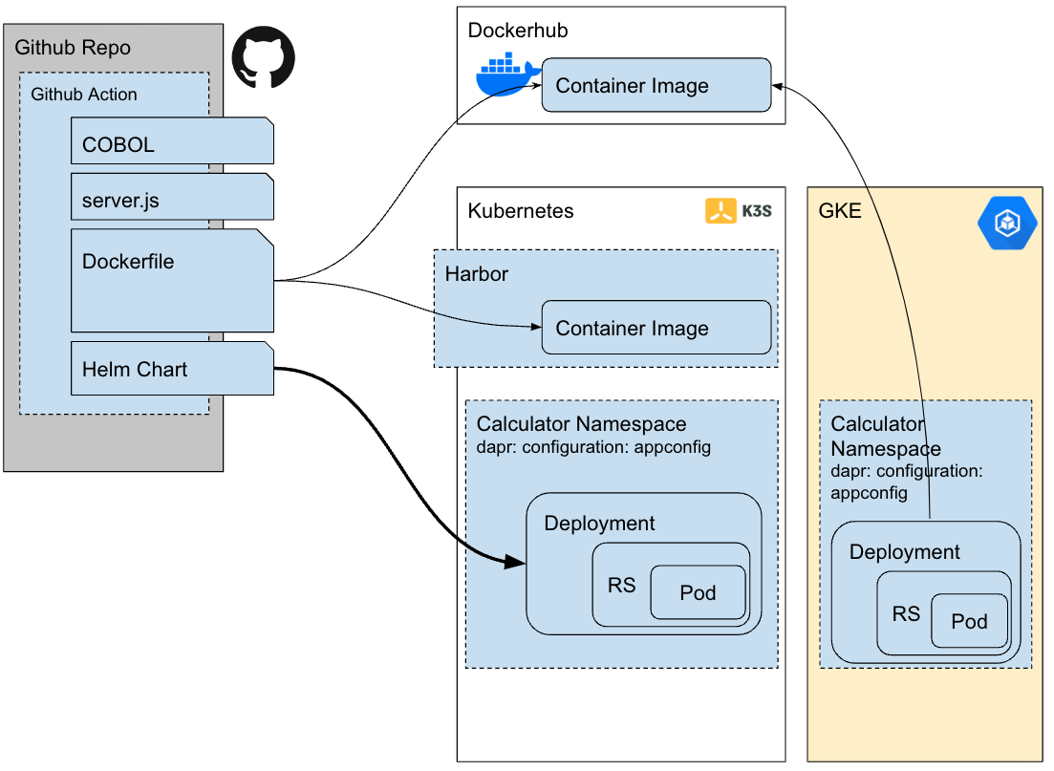
CICD Options
Choices:
AzDO, Github or Gitlab
Provided or Self-Hosted Runners
Provided Runners:
If you have an external endpoint you can use, take the free compute
Github:
Using the platform closest to the code

Slide 16
name: PR And Main Build
on:
push:
branches:
- main
pull_request:
jobs:
HostedActions:
runs-on: ubuntu-latest
steps:
- name: Check out repository code
uses: actions/checkout@v2
- name: Turn on build light
run: |
curl -s -o /dev/null https://kasarest.freshbrewed.science/on?devip=192.168.1.3
- name: Build Dockerfile
run: |
export BUILDIMGTAG="`cat Dockerfile | tail -n1 | sed 's/^.*\///g'`"
docker build -t $BUILDIMGTAG .
docker images
- name: "Dockerhub: Tag and Push"
run: |
export BUILDIMGTAG="`cat Dockerfile | tail -n1 | sed 's/^.*\///g'`"
export FINALVERSION="`cat Dockerfile | tail -n1 | sed 's/^.*://g'`"
docker tag $BUILDIMGTAG idjohnson/coboladder:$FINALVERSION
docker images
docker login -u="$DOCKER_USERNAME" -p="$DOCKER_PASSWORD"
docker push idjohnson/coboladder:$FINALVERSION
env: # Or as an environment variable
DOCKER_PASSWORD: ${{ secrets.DH_PAT }}
DOCKER_USERNAME: ${{ secrets.DH_LOGIN }}
- name: "HarborCR: Tag and Push"
run: |
export BUILDIMGTAG="`cat Dockerfile | tail -n1 | sed 's/^.*\///g'`"
export FINALBUILDTAG="`cat Dockerfile | tail -n1 | sed 's/^#//g'`"
docker tag $BUILDIMGTAG $FINALBUILDTAG
docker images
echo $CR_PAT | docker login harbor.freshbrewed.science -u $CR_USER --password-stdin
docker push $FINALBUILDTAG
env: # Or as an environment variable
CR_PAT: ${{ secrets.CR_PAT }}
CR_USER: ${{ secrets.CR_USER }}
- name: Build count
uses: masci/datadog@v1
with:
api-key: ${{ secrets.DATADOG_API_KEY }}
metrics: |
- type: "count"
name: "cobol.runs.count"
value: 1.0
host: ${{ github.repository_owner }}
tags:
- "project:${{ github.repository }}"
- "branch:${{ github.head_ref }}"
- name: Turn off build light
run: |
curl -s -o /dev/null https://kasarest.freshbrewed.science/off?devip=192.168.1.3
run-if-failed:
runs-on: ubuntu-latest
needs: [HostedActions]
if: always() && (needs.HostedActions.result == 'failure')
steps:
- name: Blink and Leave On build light
run: |
curl -s -o /dev/null https://kasarest.freshbrewed.science/off?devip=192.168.1.3 && sleep 5 \
&& curl -s -o /dev/null https://kasarest.freshbrewed.science/on?devip=192.168.1.3 && sleep 5 \
&& curl -s -o /dev/null https://kasarest.freshbrewed.science/off?devip=192.168.1.3 && sleep 5 \
&& curl -s -o /dev/null https://kasarest.freshbrewed.science/on?devip=192.168.1.3
- name: Fail count
uses: masci/datadog@v1
with:
api-key: ${{ secrets.DATADOG_API_KEY }}
metrics: |
- type: "count"
name: "cobol.fails.count"
value: 1.0
host: ${{ github.repository_owner }}
tags:
- "project:${{ github.repository }}"
- "branch:${{ github.head_ref }}"

Slide 17
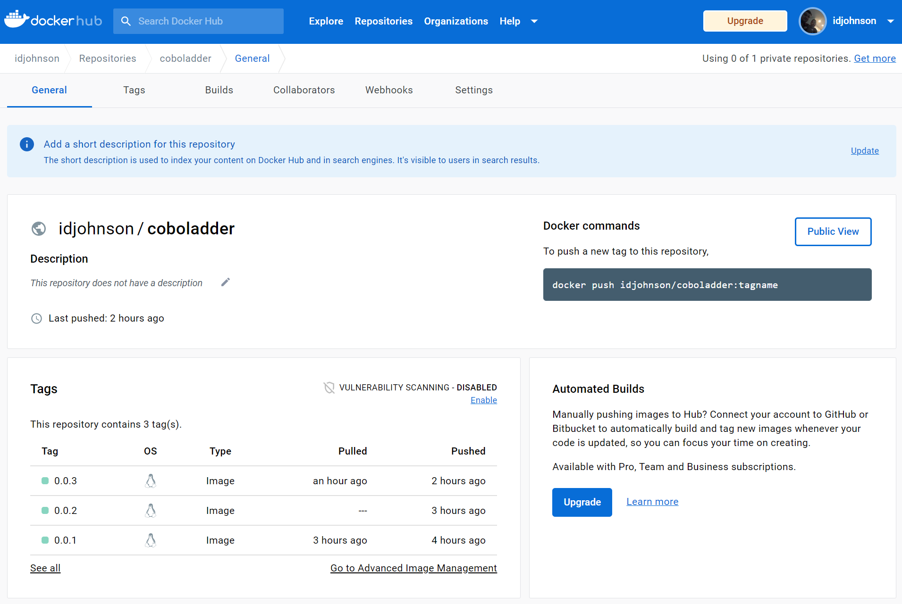
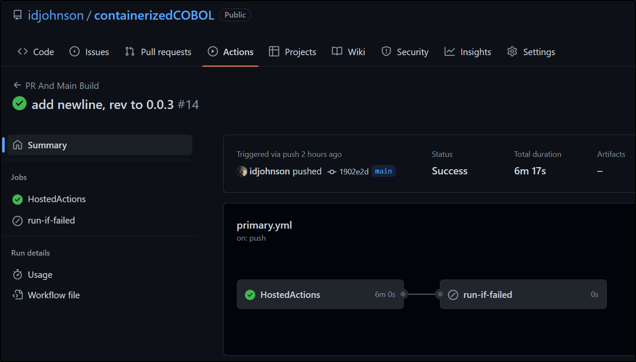
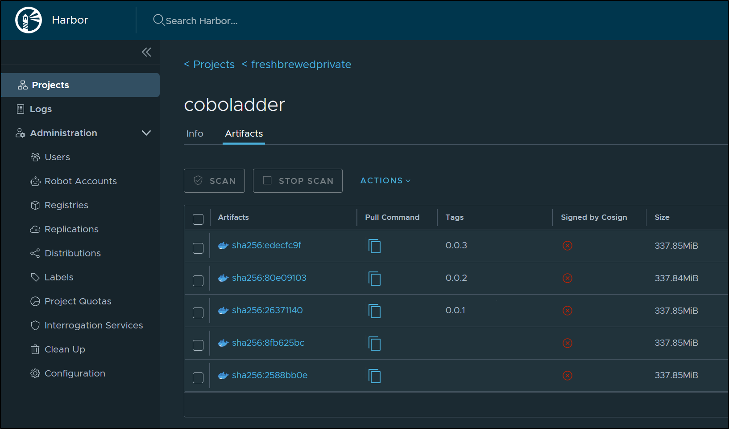
Build

Slide 18
Manual Deploys
we can apply yaml directly to swap from the "Go" adder to the "COBOL" adder
$ kubectl delete -f go-adder.yaml
deployment.apps "addapp" deleted
$ kubectl apply -f cobol-adder-public.yaml
deployment.apps/addapp created
$ kubectl get pods | grep add
addapp-677b754f58-wfm6l 2/2 Running 0 2m37s

Slide 19
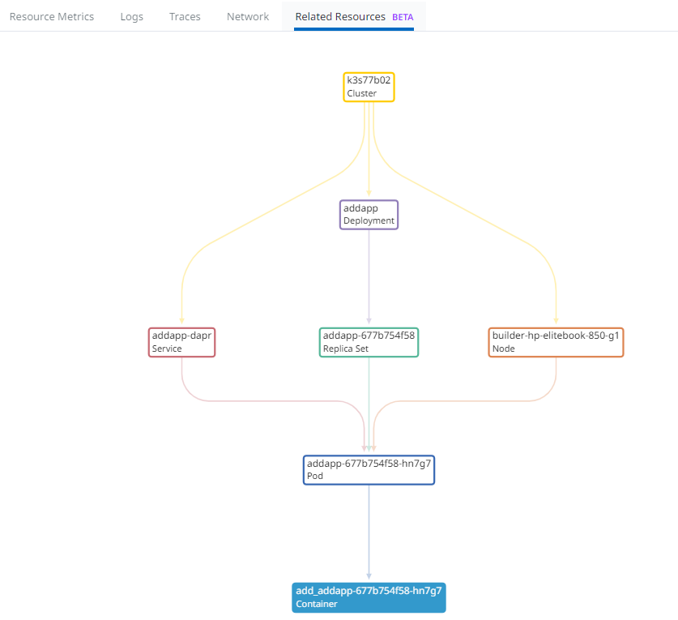
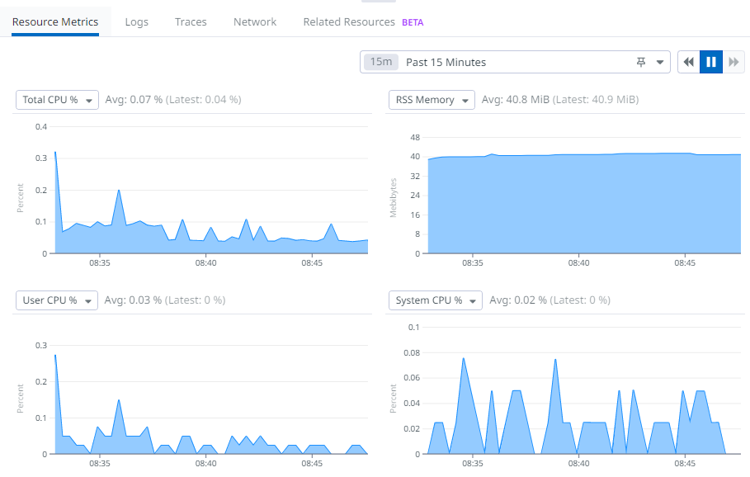
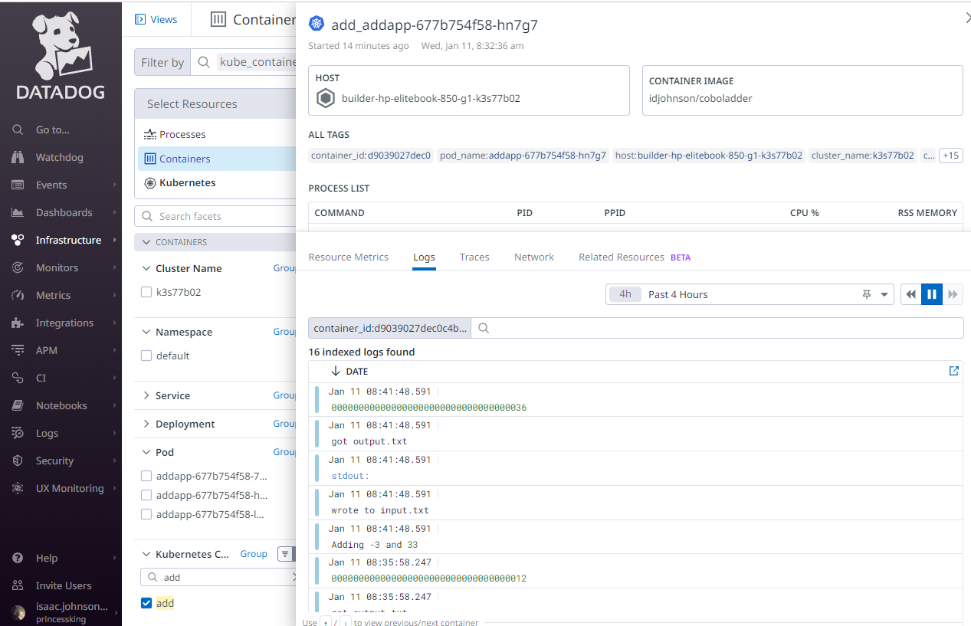
Verify Container via Datadog
Can view logs over time
Live Tail
Related Resources

Slide 20
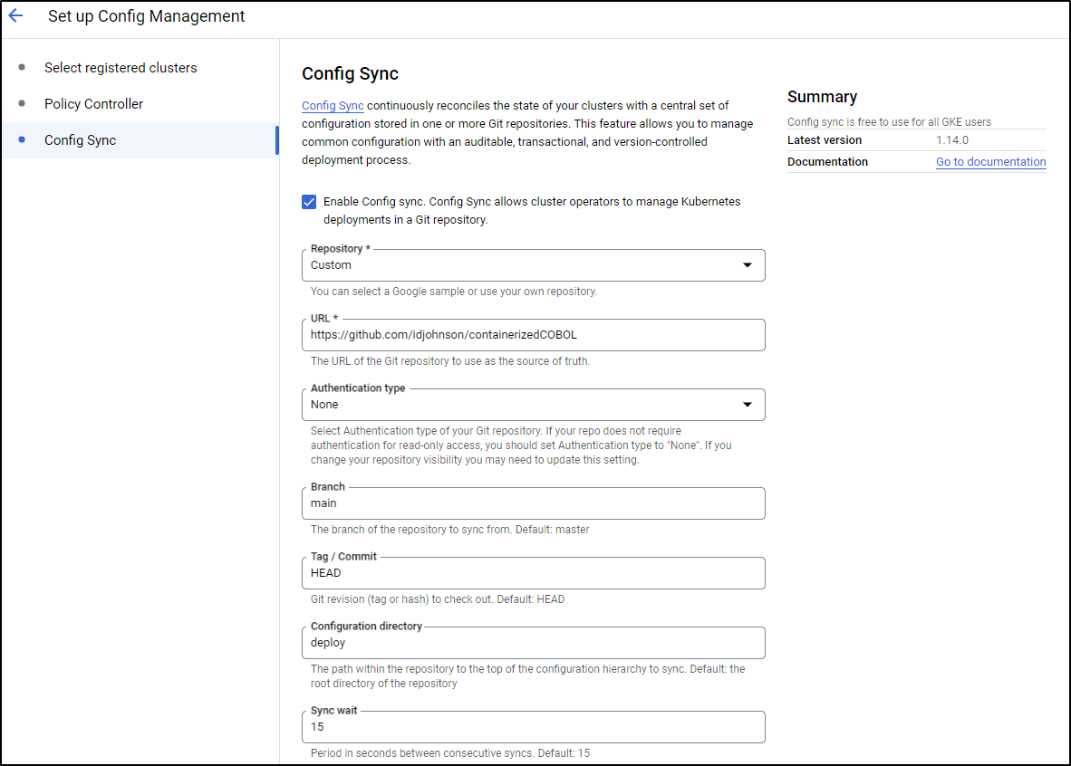
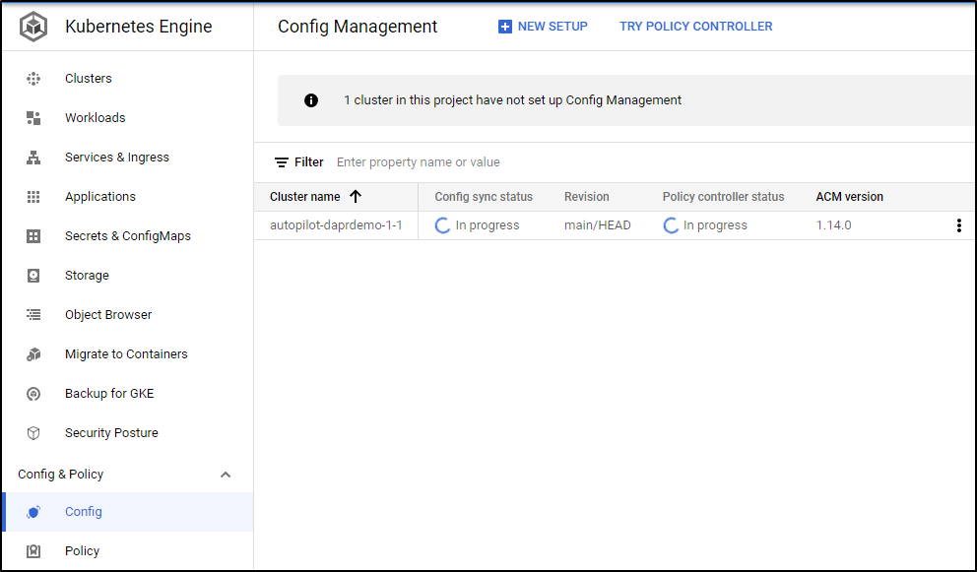
ConfigSync (GitOps)
GitOps using Config Sync

Slide 21
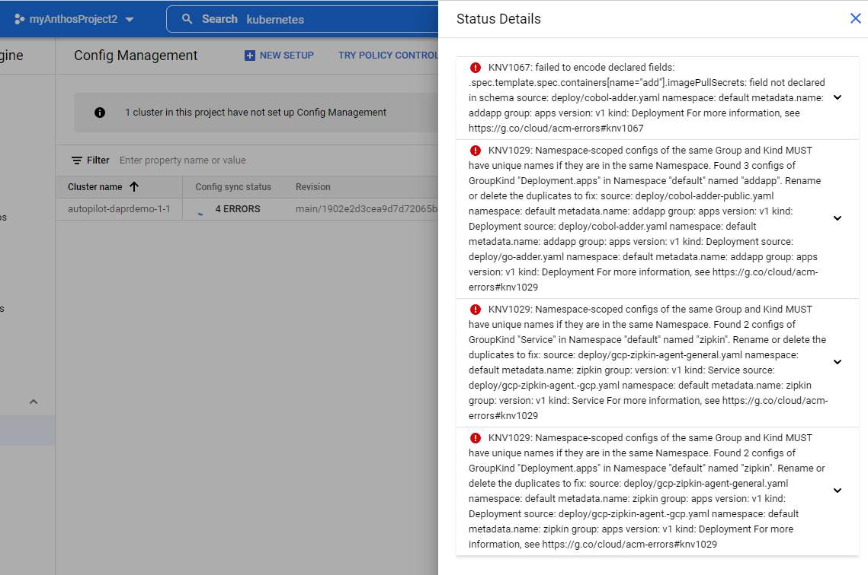
AppSync detecting errors

Slide 22
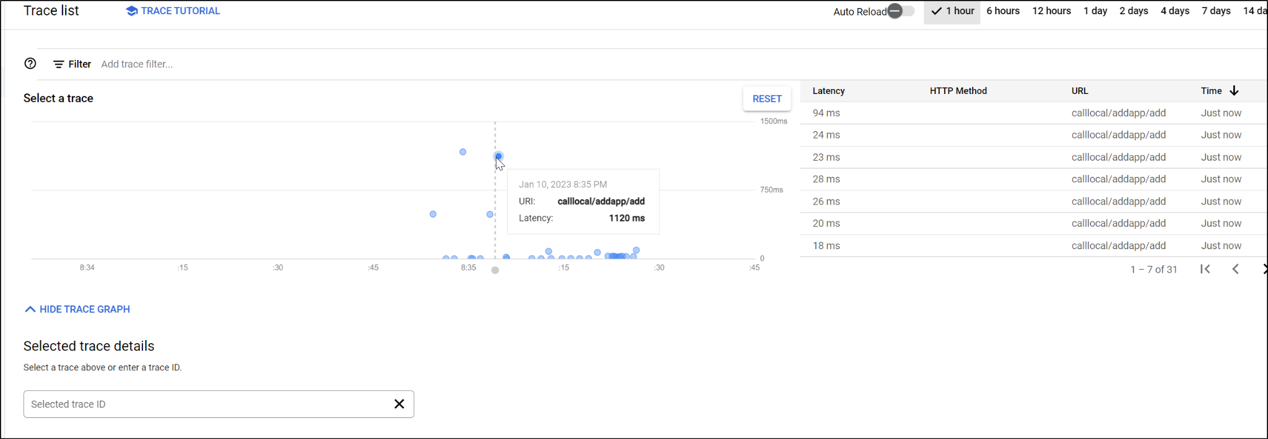
GCP Cloud Trace

Slide 23
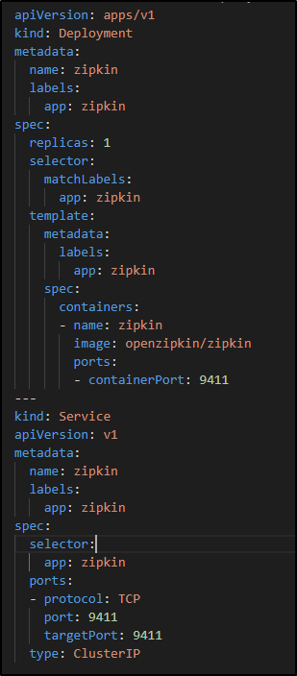
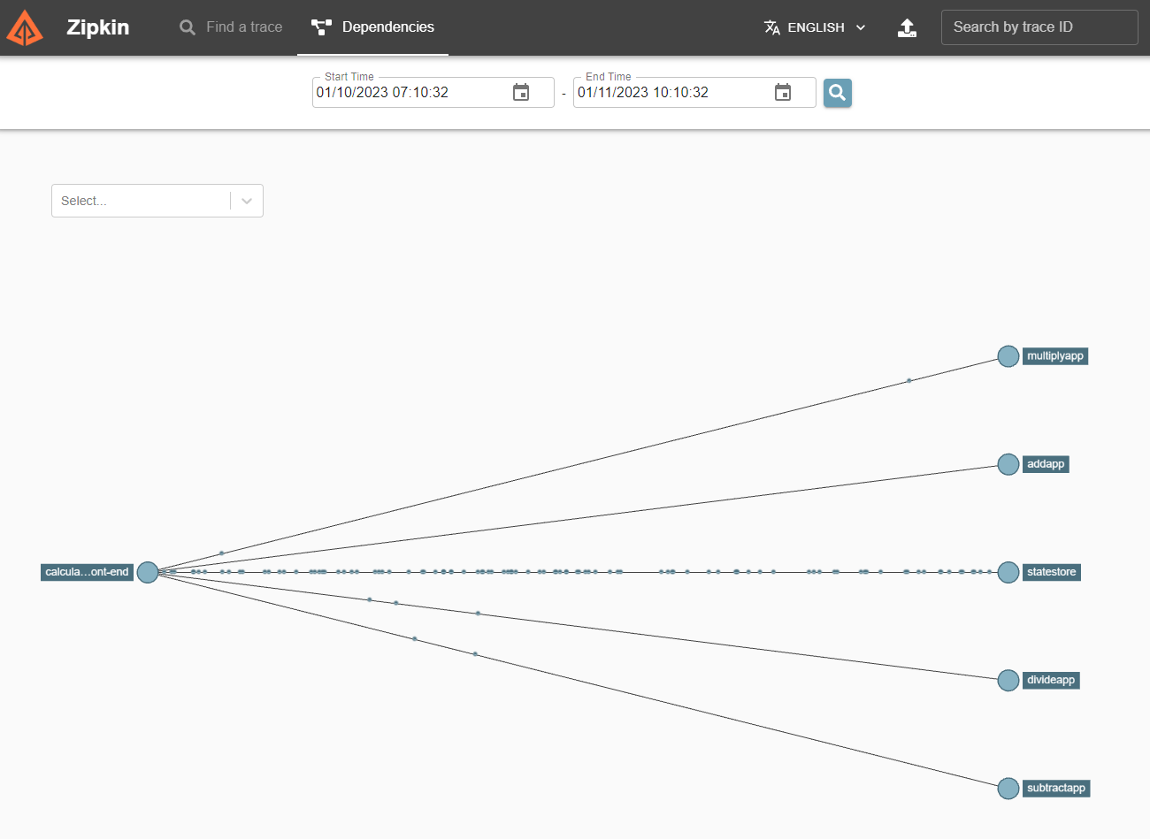
Switch to OSS Zipkin
Switch from GCP Zipkin Forwarder to standard Open Source Zipkin
Both use zipkin service endpoint - I didn't even have to change Dapr AppConfig!

Slide 24
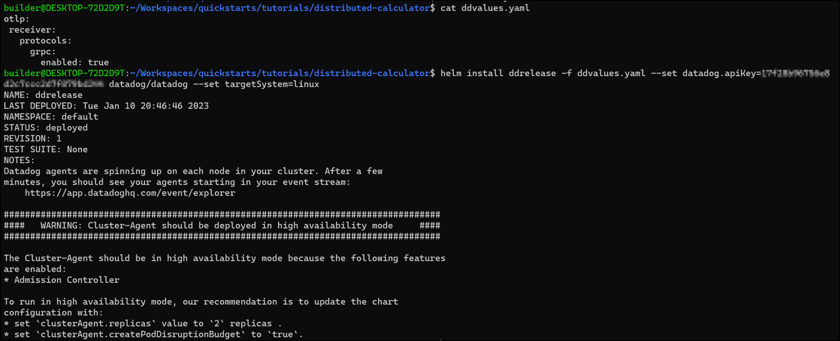
Adding Datadog (with OTLP collector)

Slide 25
Pivot
Tried gRPCand HTTP
DD Agent not receiving http or gRPC (4318 or 4317) traffic
Do not see it exposed on agent configuration

Slide 26
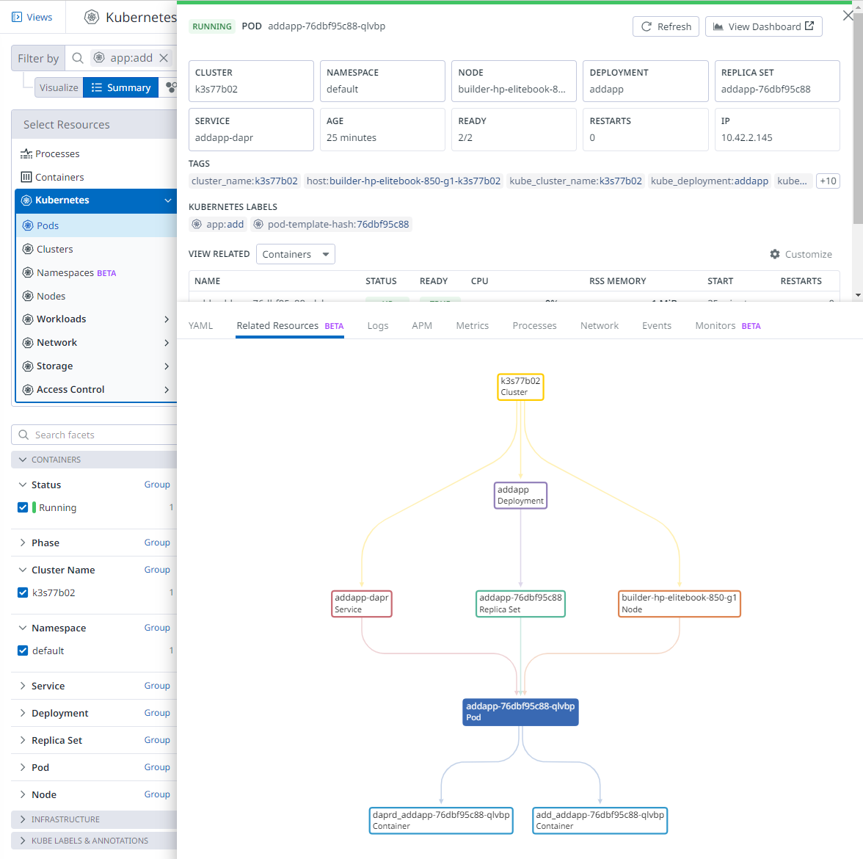
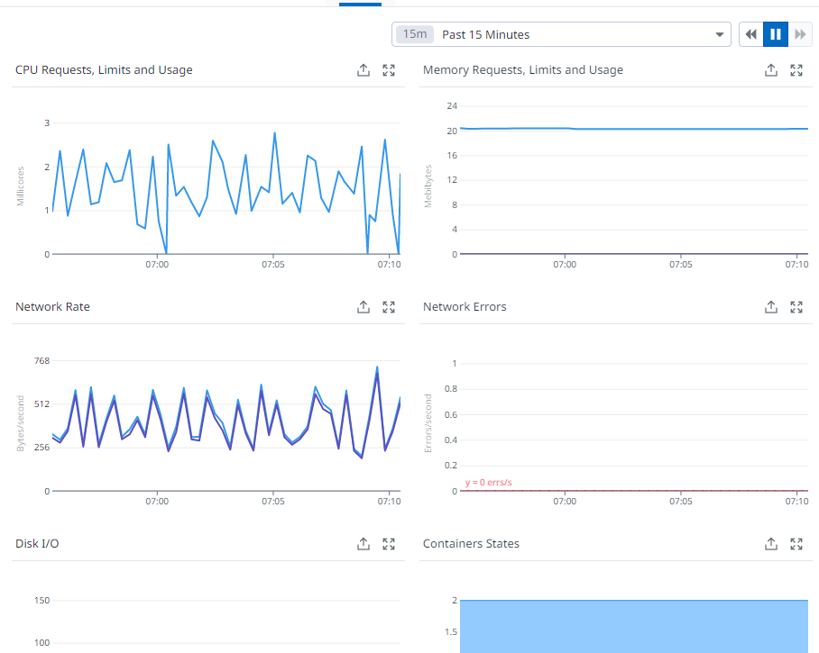
View Pods in Datadog
use Datadog to view Related Resources (without APM setup)
Metrics

Slide 27
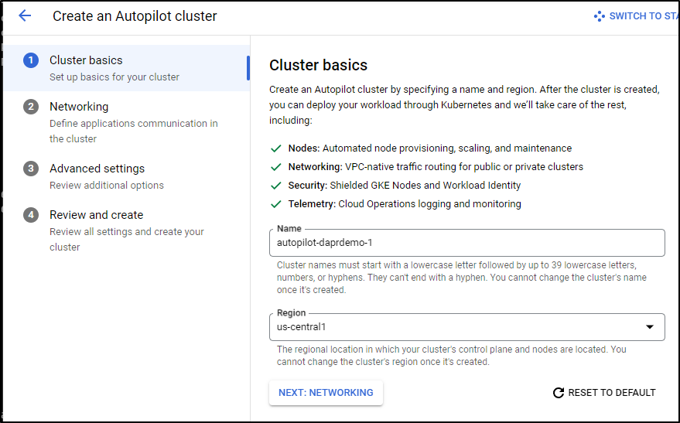
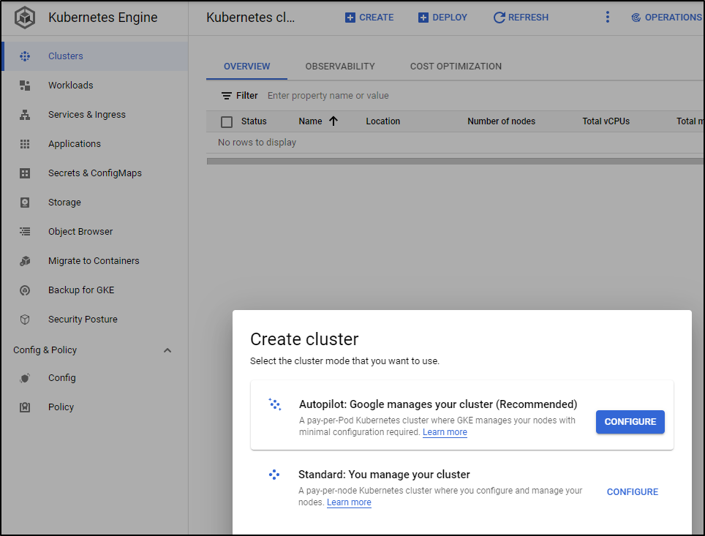
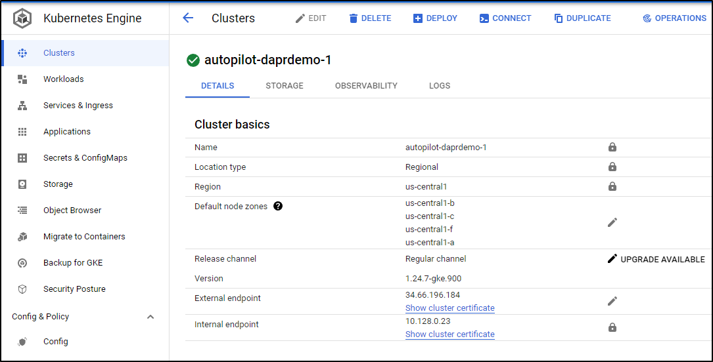
Adding GKE
Adding GKE
Using Autopilot
Use Connect to get kubeconfig

Slide 28
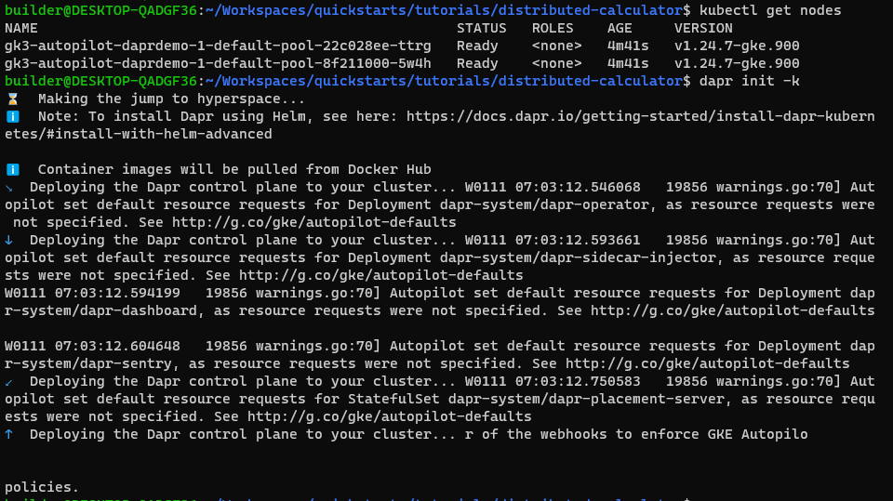
Adding Dapr to GKE
gcloud container clusters get-credentials …
dapr init -k

Slide 29
Full End to End Demo

Slide 30
Final Thoughts

Slide 31
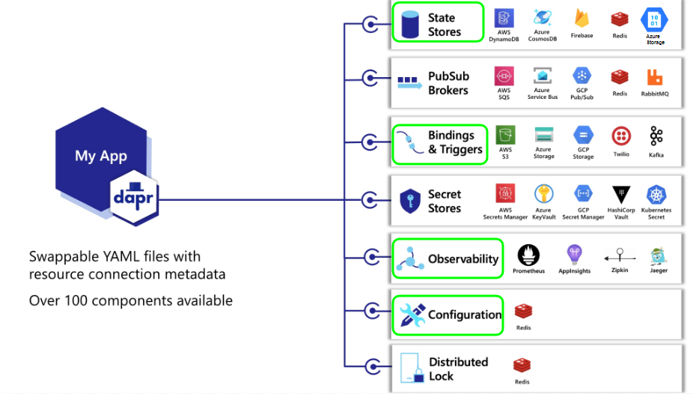
Dapr Components
Azure and Redis state stores
K3s and GKE
Service to Service bindings
Observability via Zipkin and Otel

Slide 32
Any Questions
Repo: https://github.com/idjohnson/containerizedCOBOL/
GH Workflow: https://github.com/idjohnson/containerizedCOBOL/blob/main/.github/workflows/primary.yml
ChatGPT: https://chat.openai.com/auth/login
Blog Posts
COBOL, Pascal and Perl: https://www.freshbrewed.science/containerized-cobol-pascal-and-perl-based-bbs/index.html
Fortran: https://www.freshbrewed.science/containerized-fortran-in-kubernetes/index.html

