Slide 1
Open Source & Cloud
It Just Makes Cents

Slide 2
Agenda
Cloud Costs
OpEx vs CapEx.
Open Source in Platforms, Languages, Tooling and More
Simple Tips to Minimize and Restrain Costs in the Cloud.
Budgets
CUDs / RIs
Open Source tools for Measuring, Monitoring and Mitigating Cloud Spend

Slide 3
CapEx vs OpEx
Capital Expenditures (CapEx)
Purchasing Equipment – Hardware, NOC, etc
Amortization / Depreciation
Like Buying a House
Operational Expenditures (OpEx)
Managing NOC, SaaS
Like Renting a House
Cloud is about moving from CapEx to OpEx
Pay for what you use
No more Amortization/Depreciation
More Secure
Options to move cloud vendors

Slide 4
Big Picture: Where Open-Source Fits with Cloud
Languages
Oracle Java vs Open JDK
Platform
Provisioning / IaC
OS like RHEL or Windows Server vs. CoreOS, Ubuntu, and other Linux
Tower Vs AWX
Terraform
Monitoring + Control
KubeCost Cloud Custodian

Slide 5
Languages and Platforms
IaC, Operating Systems and Frameworks

Slide 6
Languages: Java
01

Slide 7
Timeline
95
00
06
Sun Microsystems Introduces Java
Java taught in Universities
Sun GPLs Java
09
18
19
Java SE 8 licensing
Oracle “buys” Sun
Java 11 release
Here at UST, Pascal/C++ to Java in 2001
GPL 2. Initial release May 8, 2007
21
Free again for Commercial use…
MySQL > MariaDB Hudson > Jenkins
Restrictive licensing on JDF
Businesses require Oracle Subscription for Updates
Notes:
Free again: https://sdtimes.com/java/report-percentage-of-oracle-jdk-distributions-in-java-ecosystem-drops-significantly/

Slide 8
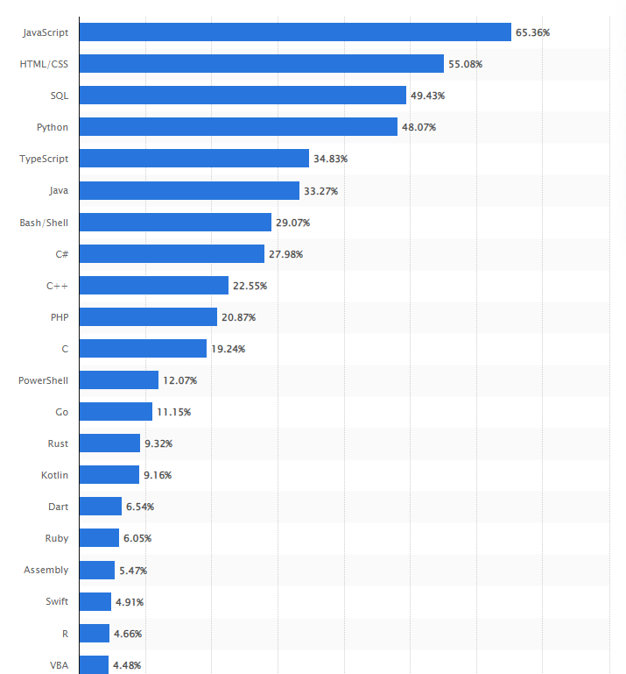
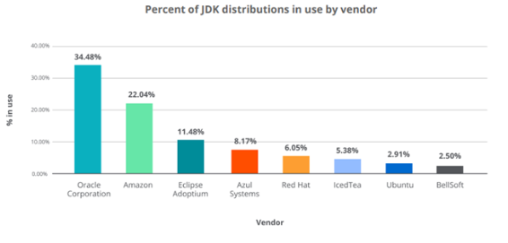
A Case Study on Oracle Java
As of 2022, Oracle has 34.48% of JDK Distributions* down from 75% in 2020.
As a language, it still is used by 33% of developers according to a Statista survey in 2022**
Notes:
New Relic Report by way of SD Times article: https://sdtimes.com/java/report-percentage-of-oracle-jdk-distributions-in-java-ecosystem-drops-significantly/
https://www.statista.com/statistics/793628/worldwide-developer-survey-most-used-languages/

Slide 9
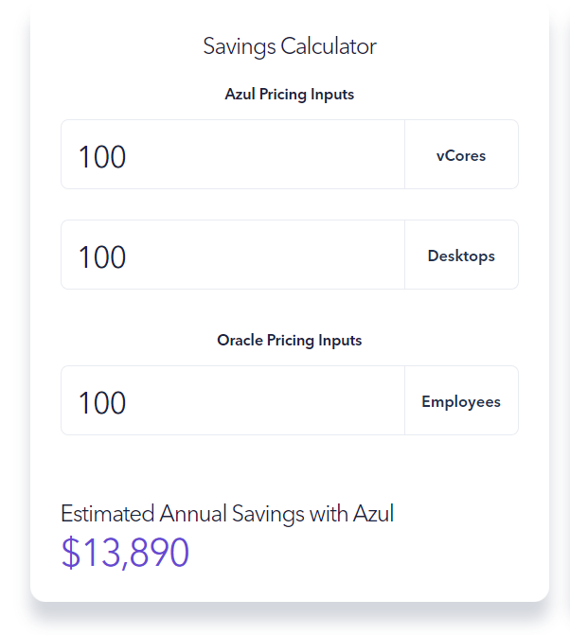
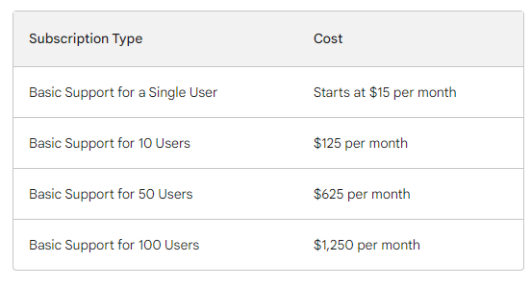
Open JDK
Oracle JDK
Built and Supported by Cloud Vendors
Robust binaries from Amazon, Azul, others
License Cost for 10 Developers: Free
License Cost for 10,000 Developers: Free
Cost for support: varies by Vendor
The cost of Oracle JDK 14 licensing for 100 developers was $28,500 per year
At times, Java SE is $5000/year/server processor, $1100 support fee/processor, $110 per named user, $22/annual support per user
New SE Plans $25/mon per processor, incl cloud. $2.50/mo per user
Now $15/mo per employee. Volume for customers of 50k employees.
SE Adv Desktop at $40/Named User Plus (NUP), SE Adv at $100/NUP and SE Suite at $300/NUP
Jan 2023, changed again to per employee, including all part time/temps. For 250 employees on 20 Desktops and 8 CPUs, that goes from $3k/year to $45k/year.
Notes:
How much does Java cost?. This article details the available… | by Suren Konathala | TechInPieces | Medium AWS Corretto (Their JDK) covered under AWS Support Contracts
Named User Plus

Slide 10
On Languages
Language Vendors Like Oracle can change licensing terms often with huge impacts to annual costs
Tying into a specific vendors implementation can create Vendor Lock-in
Limits the Kind/Cost of Developers you can hire and the creative solutions they can apply
Open Source Language Providers like Azul and Red Hat have great value-adds for when you need the extra support without impact to the products’ licensing terms

Slide 11
Docker
A Lesson in What Not To Do

Slide 12
Short happy life of Docker Swarm Enterprise
13
14
16
Docker Released
Docker Swarm First Introduced
Docker Swarm Mode
Google Introduces Kubernetes, June 2014
2017: Docker integrates Swarm with Docker EE
19
Docker Swarm/ Enterprise Sold to Mirantis
Docker is born PyCon 2013 first demo
Docker “Enterprise Support 1.0” June 2014
Docker Swarm is free, but Docker Trusted Registry (DTR) and Univiseral Control Pane (UCP) require licenses
Docker Enterprise goes away
Notes:
https://support.hpe.com/hpesc/public/docDisplay?docId=a00072194en_us&docLocale=en_US

Slide 13
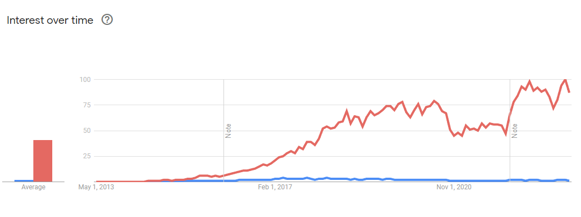
Docker Swarm vs Kubernetes
Google Trends – Interest (web search)
Notes:
https://www.linkedin.com/pulse/docker-vs-kubernetes-gary-lee-baird/
https://trends.google.com/trends/explore?date=2013-04-03%202023-05-03&geo=US&q=Docker%20Swarm,%2Fg%2F11b7lxp79d

Slide 14
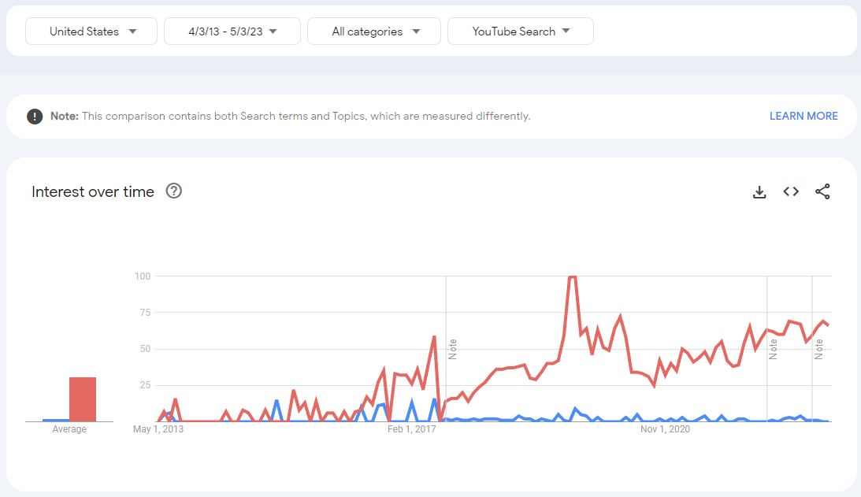
Docker Swarm vs Kubernetes
Google Trends – Interest (YouTube)
Notes:
https://trends.google.com/trends/explore?date=2013-04-03%202023-05-03&geo=US&gprop=youtube&q=Docker%20Swarm,%2Fg%2F11b7lxp79d

Slide 15
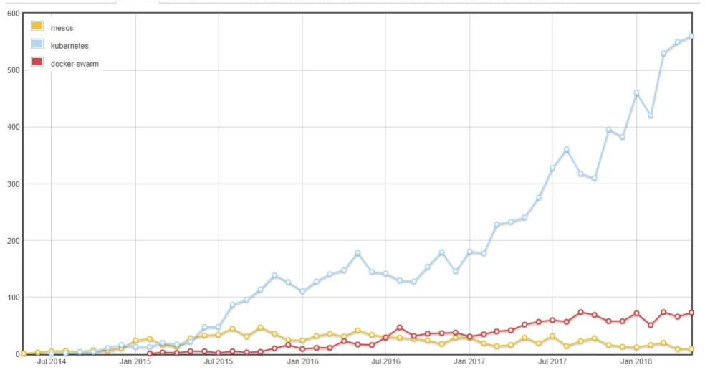
Docker Swarm vs Kubernetes
Github Questions / Stars
Notes:
https://rdodev.medium.com/saved-you-an-analyst-read-on-kubernetes-growth-2018-edition-810367876981
https://percona.community/blog/2019/07/08/tame-kubernetes-with-open-source-tools/

Slide 16
Short happy life of Docker Swarm Enterprise
13
14
16
Docker Swarm Mode
Docker Released
Docker Swarm First Introduced
14: Azure Kubernetes Engine (AKS)
15: Google Kubernetes Engine (GKE)
18: Amazon Elastic Kubernetes Service (EKS)
19
Docker Swarm/ Enterprise Sold to Mirantis
HPE stops sales and support 2019 (with sale)
Notes:
https://support.hpe.com/hpesc/public/docDisplay?docId=a00072194en_us&docLocale=en_US

Slide 17
The real reason Open Source won
“[ Swarm ] was not a production solution, because it had no feature for plugging into cloud storage in a reliable, repeatable way” – Josh Berkus, RH Kubernetes
Only One Vendor was really supporting building out Docker Swarm
ALL the Clouds were all in to Kubernetes by 2018 – and the CNCF was (and is) STRONG
Notes:
https://increment.com/containers/docker-ce-and-ee/

Slide 18
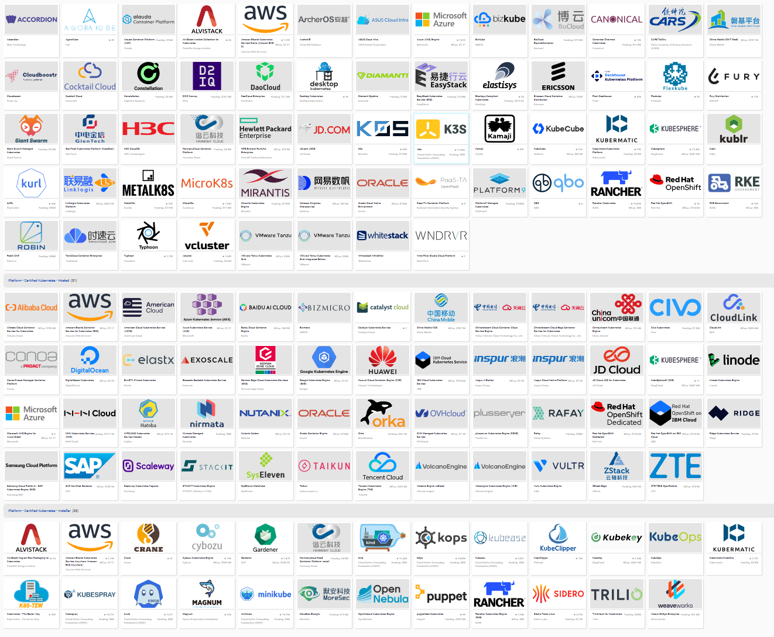
CNCF Landscape
Notes:
https://landscape.cncf.io/card-mode?category=certified-kubernetes-distribution,certified-kubernetes-hosted,certified-kubernetes-installer&grouping=category

Slide 19
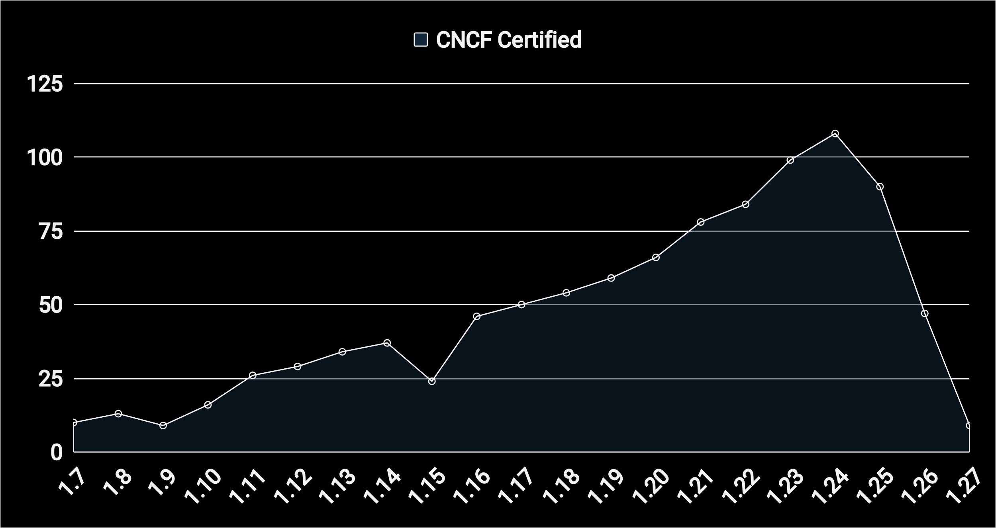
CNCF Certified Kubernetes Distributions
Kubernetes 1.7 (July 2017) had 10 CNCF Certified Distributions
Kubernetes 1.24 (Stargazer) released May 2022 has 108 CNCF Certified Distributions
1.27, now just 3w old as of writing, already has 9 certified CNCF certified distributions

Slide 20
Operating Systems
02

Slide 21
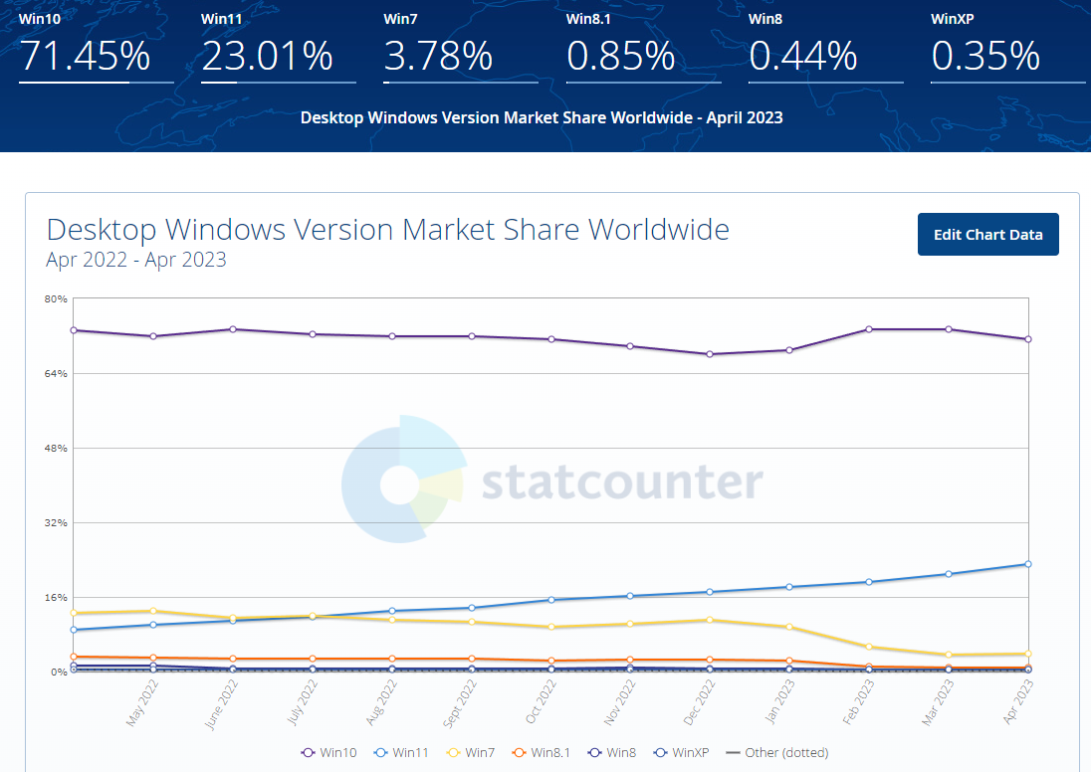
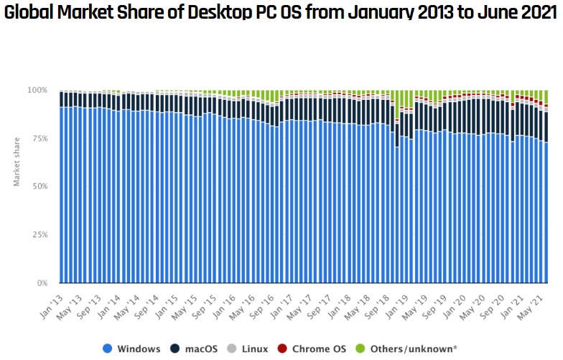
Market trends
Windows may be Dominant OS, however, with Windows 10 comes WSL
SO 2022 Survey found 15% of devs use WSL and 40% use Linux
31% Mac OS and 62% using Windows
Notes:
https://www.zdnet.com/article/microsofts-windows-subsystem-for-linux-just-hit-a-major-milestone/

Slide 22
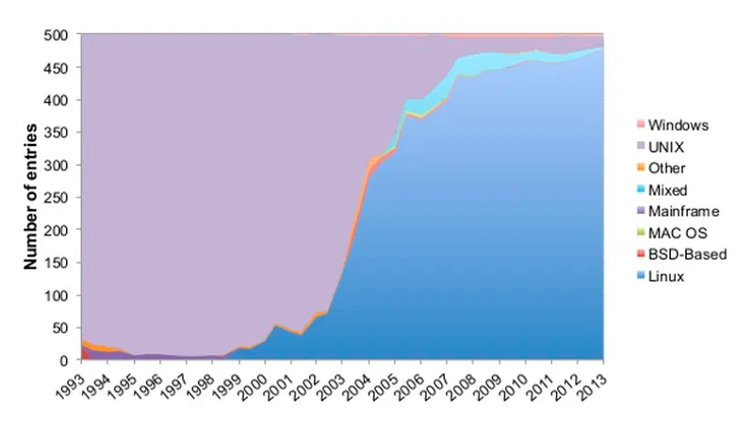
Market trends in Super Computers
China with 213 Supercomputers and US with 113
Linux nearing 100%
Notes:
https://earthweb.com/operating-system-market-share/

Slide 23
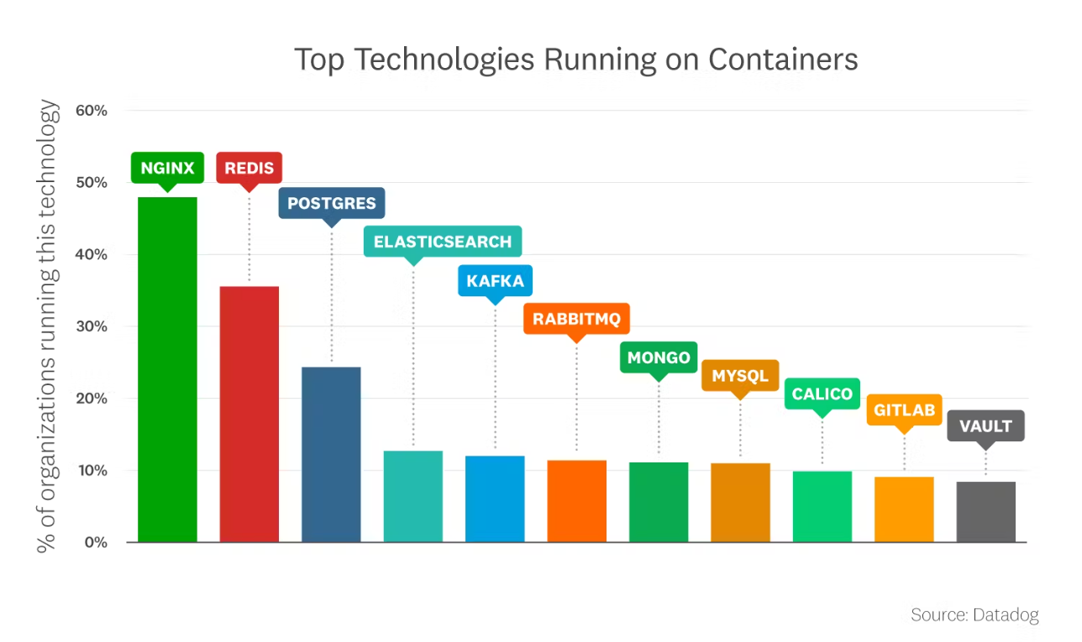
Top Containers
All are Open-Source
Notes:
https://www.datadoghq.com/state-of-application-security/?utm_source=organic&utm_medium=display&utm_campaign=dg-organic-websites-ww-corpsite-announcement-report-applicationsecurity2023

Slide 24
Open Source and the Operating System
All current Operating Systems either have Linux underpinnings (Mac OS/BSD) or Linux as an Option (WSL)
Most browsers are Open-source (either based on Chromium or Firefox)
Almost all current Supercomputers are Linux based
The Top Containers are all based on Open Source Projects
Notes:
https://increment.com/containers/docker-ce-and-ee/

Slide 25
What happened to CoreOS?

Slide 26
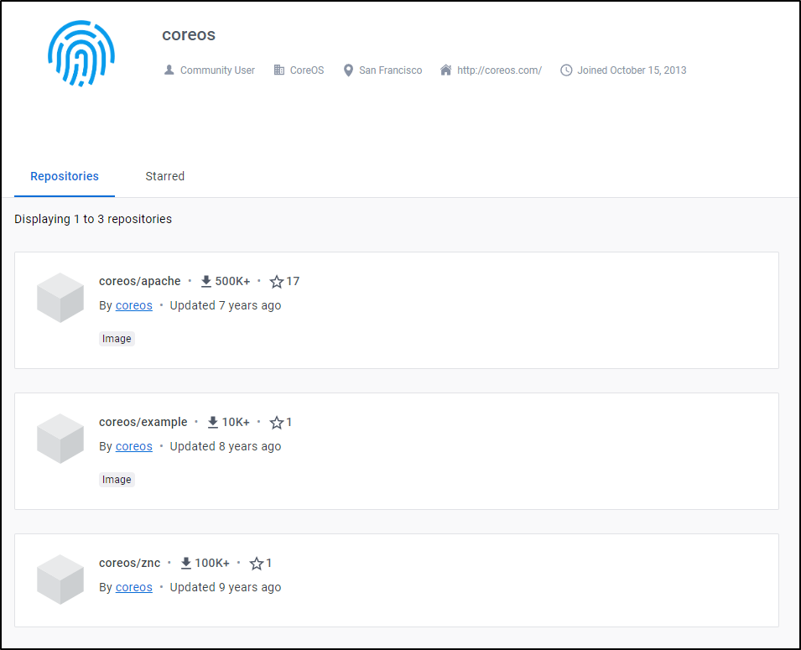
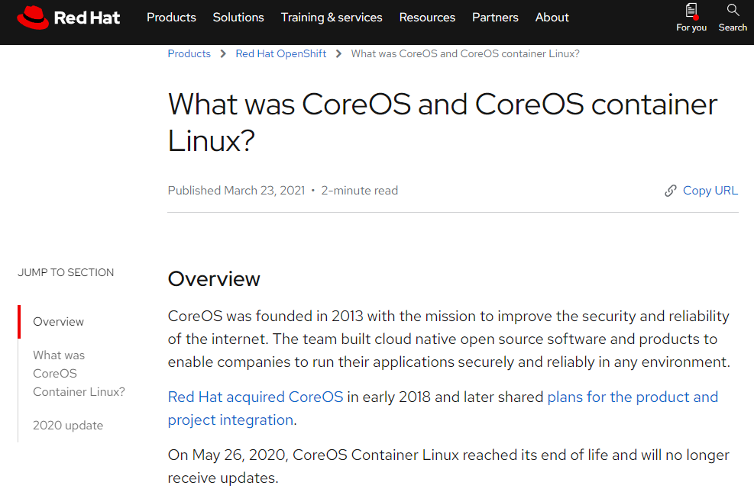
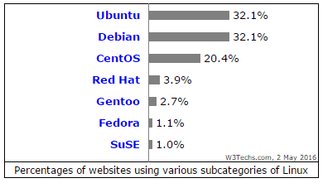
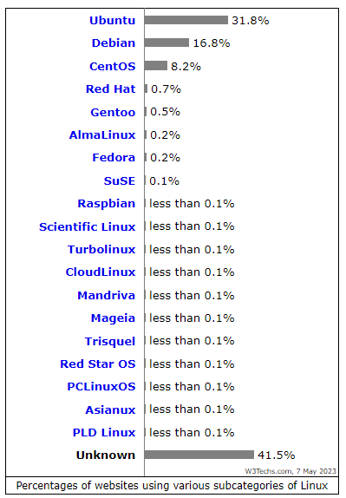
Top Linux Distros
Red Hat hit $1b sales in 2010
Sold to IBM in 2019 (key was OpenShift)
CoreOS
Notes:
https://www.datadoghq.com/state-of-application-security/?utm_source=organic&utm_medium=display&utm_campaign=dg-organic-websites-ww-corpsite-announcement-report-applicationsecurity2023

Slide 27
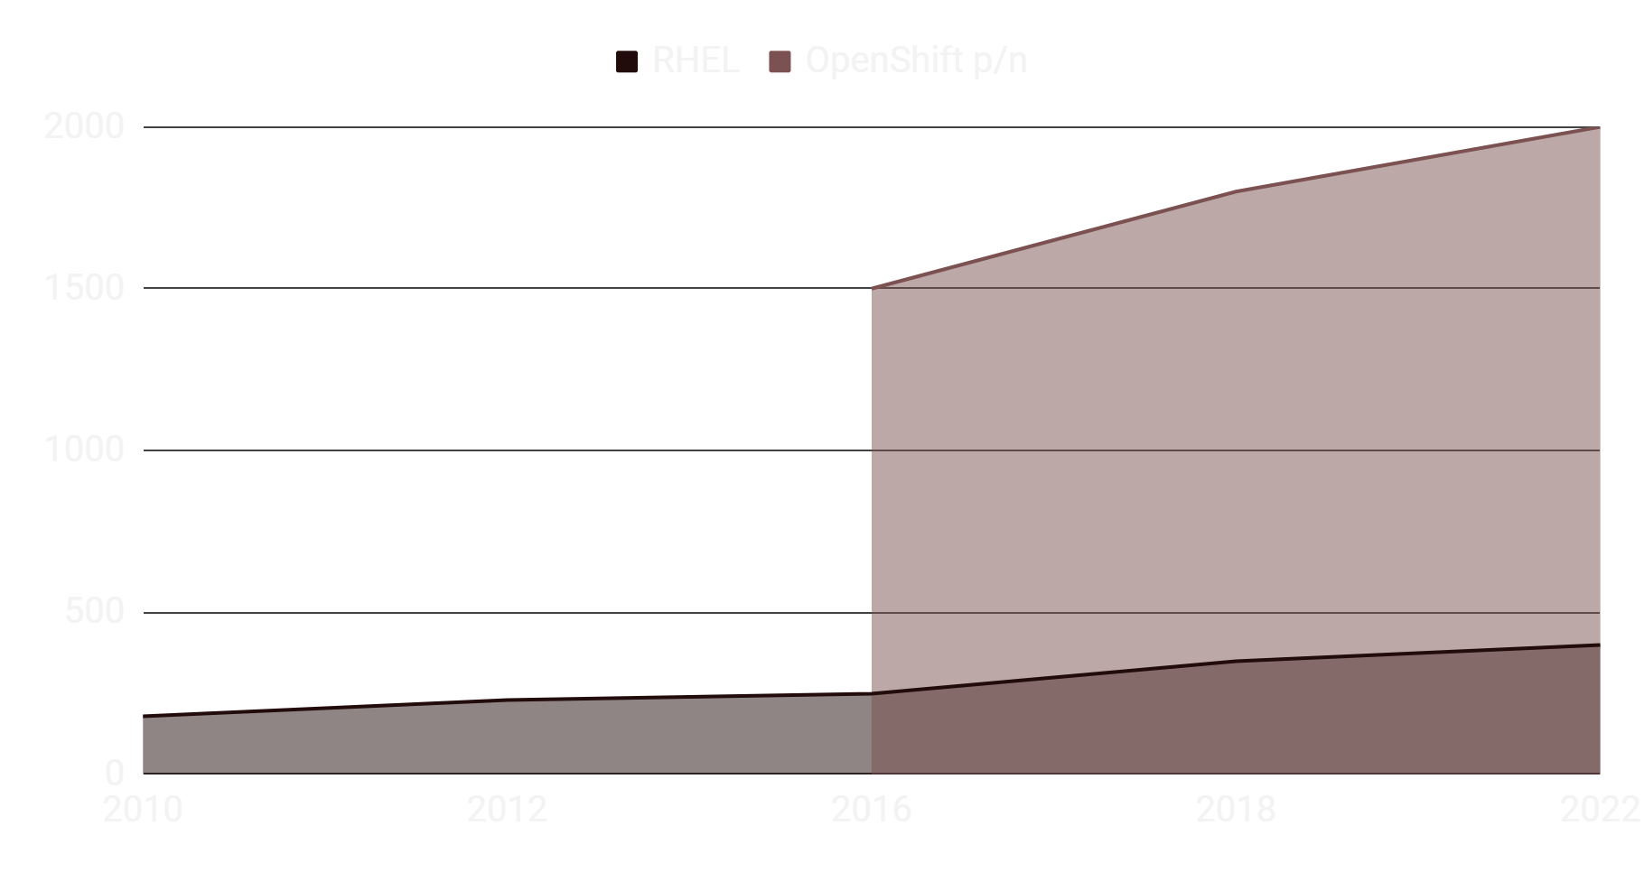
RedHat Linux Licensing Prices over time
RHEL was $179/y/server in 2010 and $399/y/server in 2022
OpenShift is presently $2000/node for licensing
Openshift Released in 2013

Slide 28
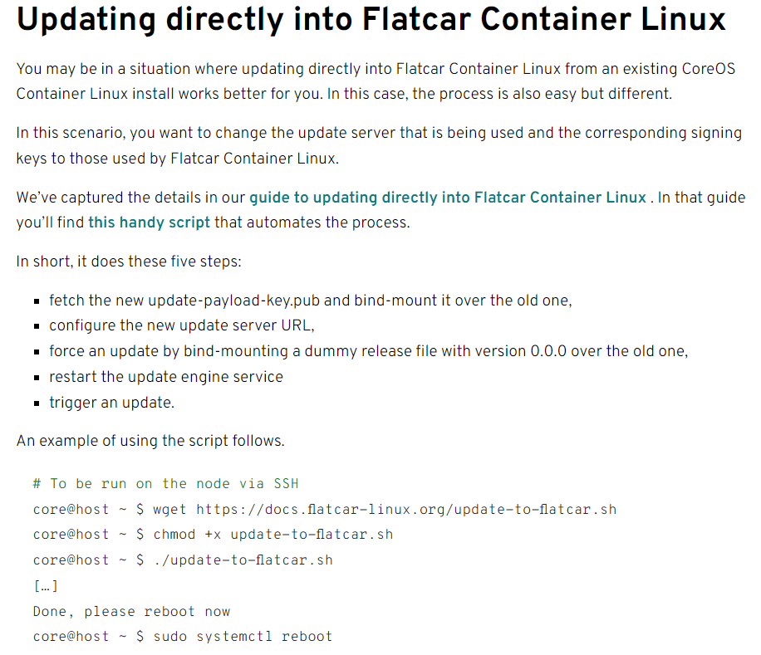
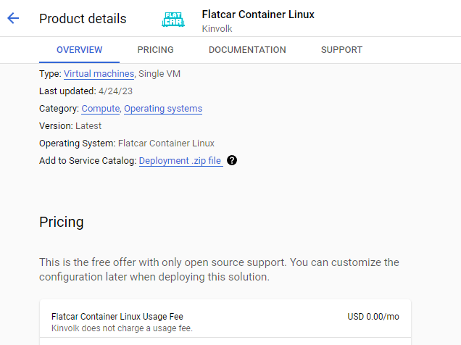
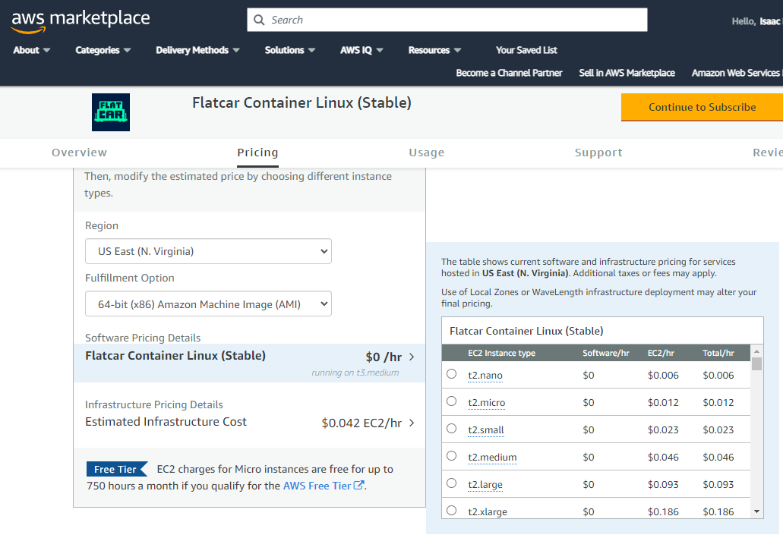
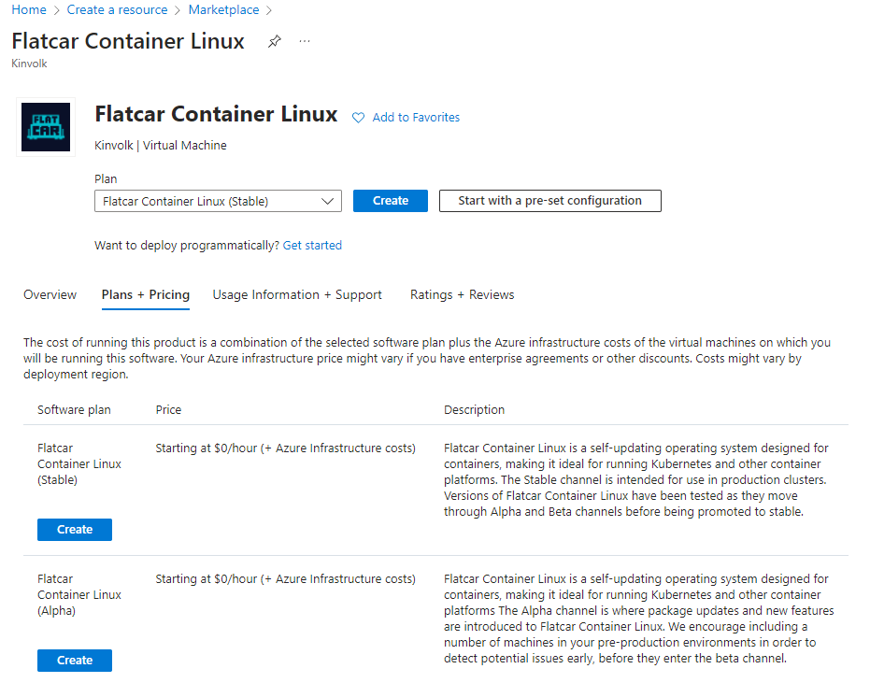
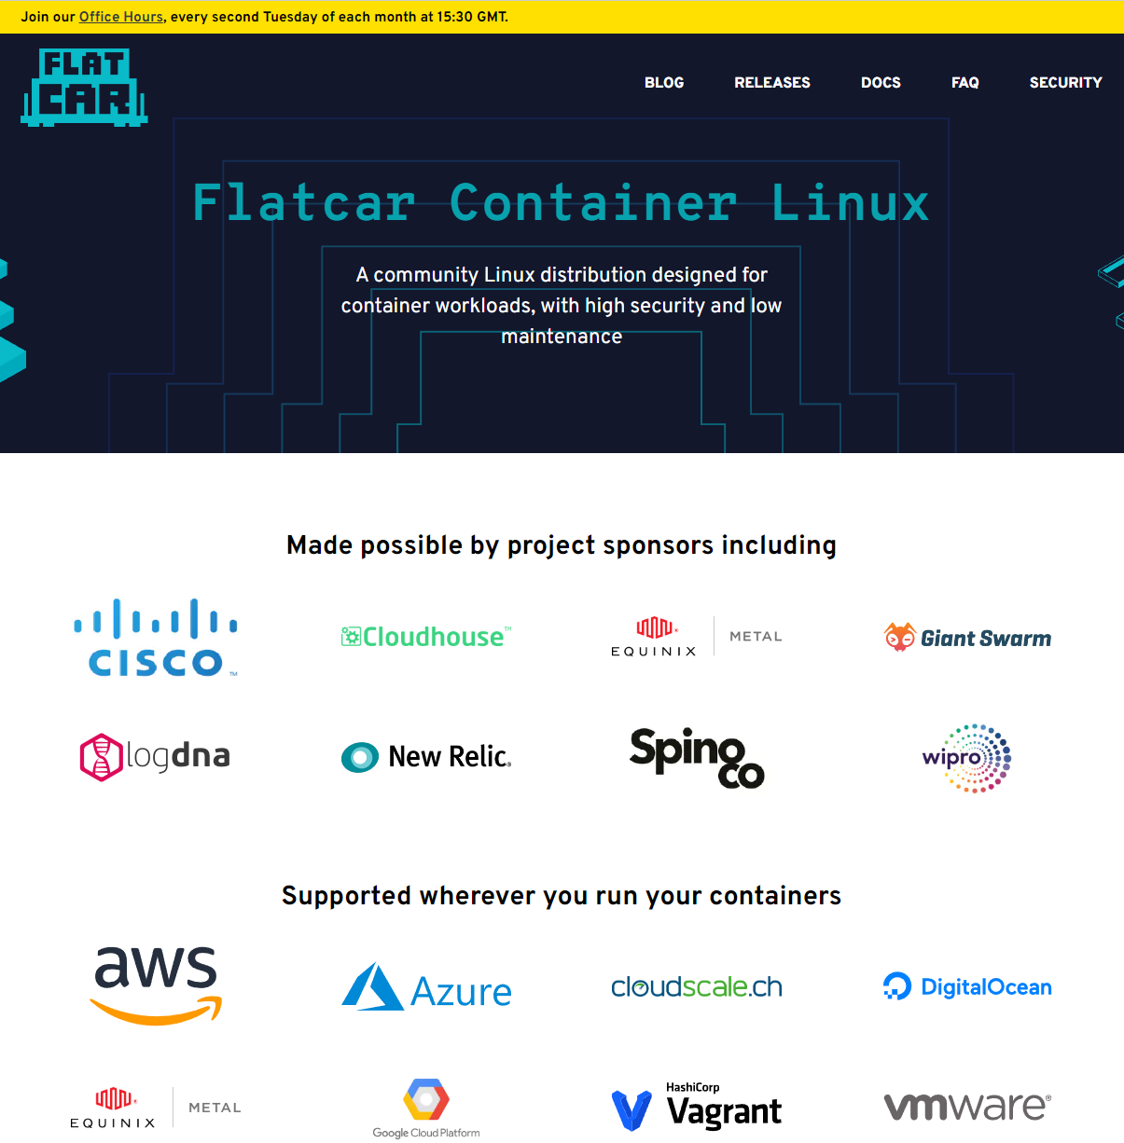
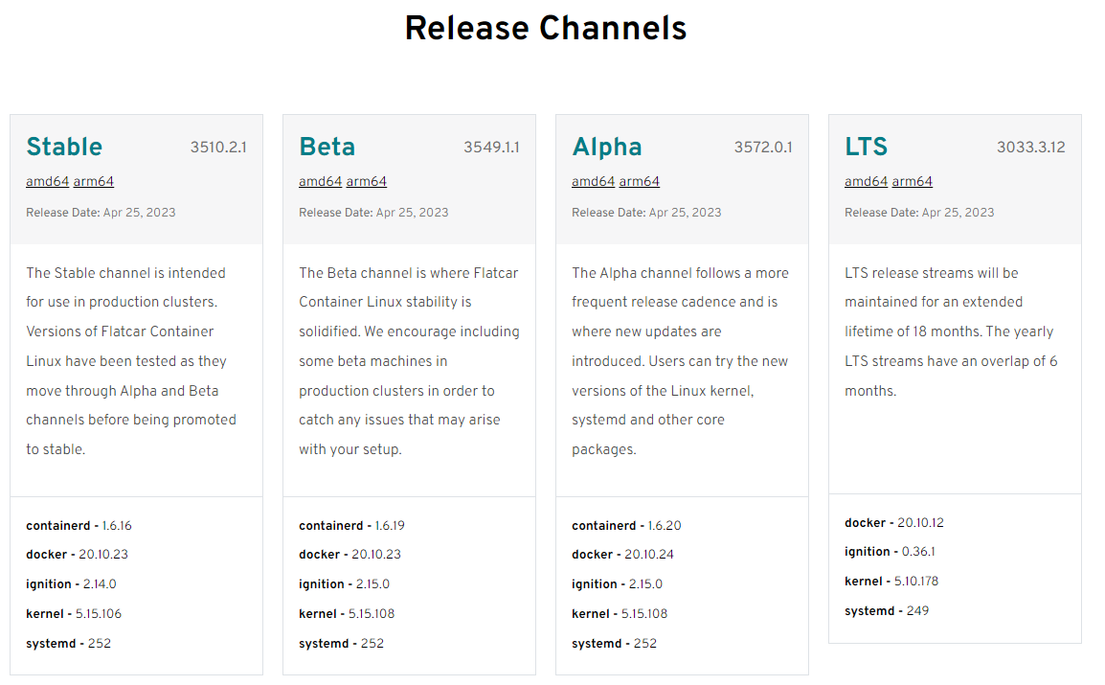
Migrating from CoreOS
Flatcar
Migration Steps
Active channels
Option in all clouds
No official Docker images
Notes:
https://www.datadoghq.com/state-of-application-security/?utm_source=organic&utm_medium=display&utm_campaign=dg-organic-websites-ww-corpsite-announcement-report-applicationsecurity2023

Slide 29
Open Source:
Single Vendor / non-OS:
Operating Systems, Container Providers/Orchestrators, Langauges
Sold off and shuttered
Slowly creep up in prices – just for licensing.
Limit hiring options
Long-term Tech Debt
Alive and maintained – Community Backed
Commercial offerings for Support and value-adds
Increase Innovation and Hiring Options

Slide 30
Provisioning and IaC:
03

Slide 31
Ansible & AWX
When OS Goes Faster

Slide 32
Timeline
13
15
17
AnsibleWorks
RH Acquisition
RH Launches OS Tower – AWX Project
19
19
22
RH AAP in AWS/Azure Marketplace
Tower becomes AAP
IBM Buys RH
Michael DeHaan (Cobbler) and Timothy Gerla
$100m
With Ansible 3.2
23
AAP in GCP Marketplace
Tower+Engine+RH Network Automation
Notes:
Free again: https://sdtimes.com/java/report-percentage-of-oracle-jdk-distributions-in-java-ecosystem-drops-significantly/

Slide 33
Jetbrains Dev Survey 2019

Slide 34
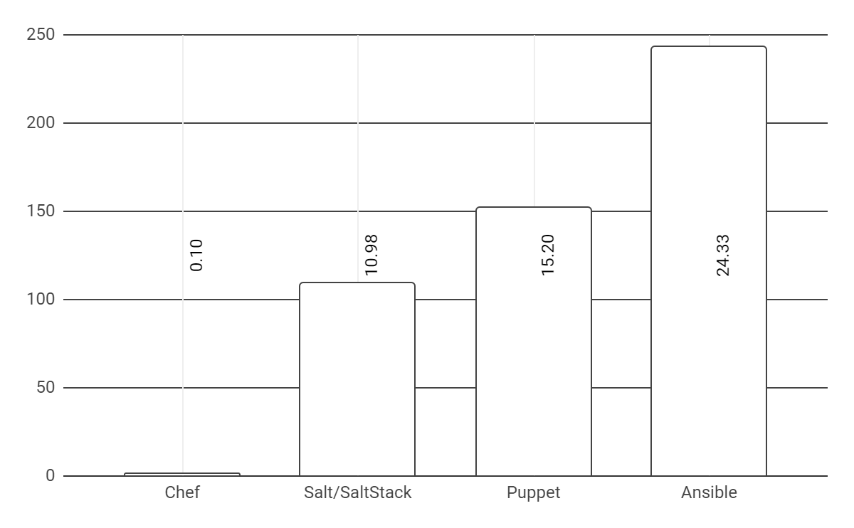
Ansible Adoption
Market share
Ansible
Puppet
Salt
Chef near bottom
Top at 24.33%. Terraform at 21.84%
Holds to 15.20% (7,635 websites to Ansibles reported 12,220)
MS System Config Manager between Puppet and Salt at 14.16%
Source: Datanyze
Only 48 reported sites
Notes:
https://www.datanyze.com/market-share/configuration-management--313/ansible-market-share 6sense: Ansible has market share of 32.26% in configuration-management market. Ansible competes with 31 competitor tools in configuration-management category. The top alternatives for Ansible configuration-management tool are Terraform with 28.96%, Puppet with 16.85%, Chef with 8.14% market share.

Slide 35
Bard: Comparing tools
 | Ease of Use | Speed | Community Support | Flexibility
Ansible | Easy | Fast | Large and Active | Very Flexible
Chef | Moderately difficult | Slow | Large | Flexible
Puppet | Difficult | Slow | Medium | Less Flexible
RedHat/IBM
Progress
Perforce

Slide 36
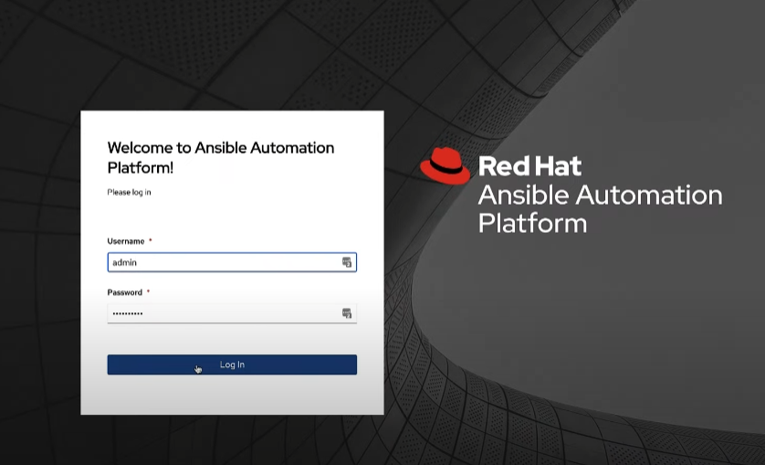
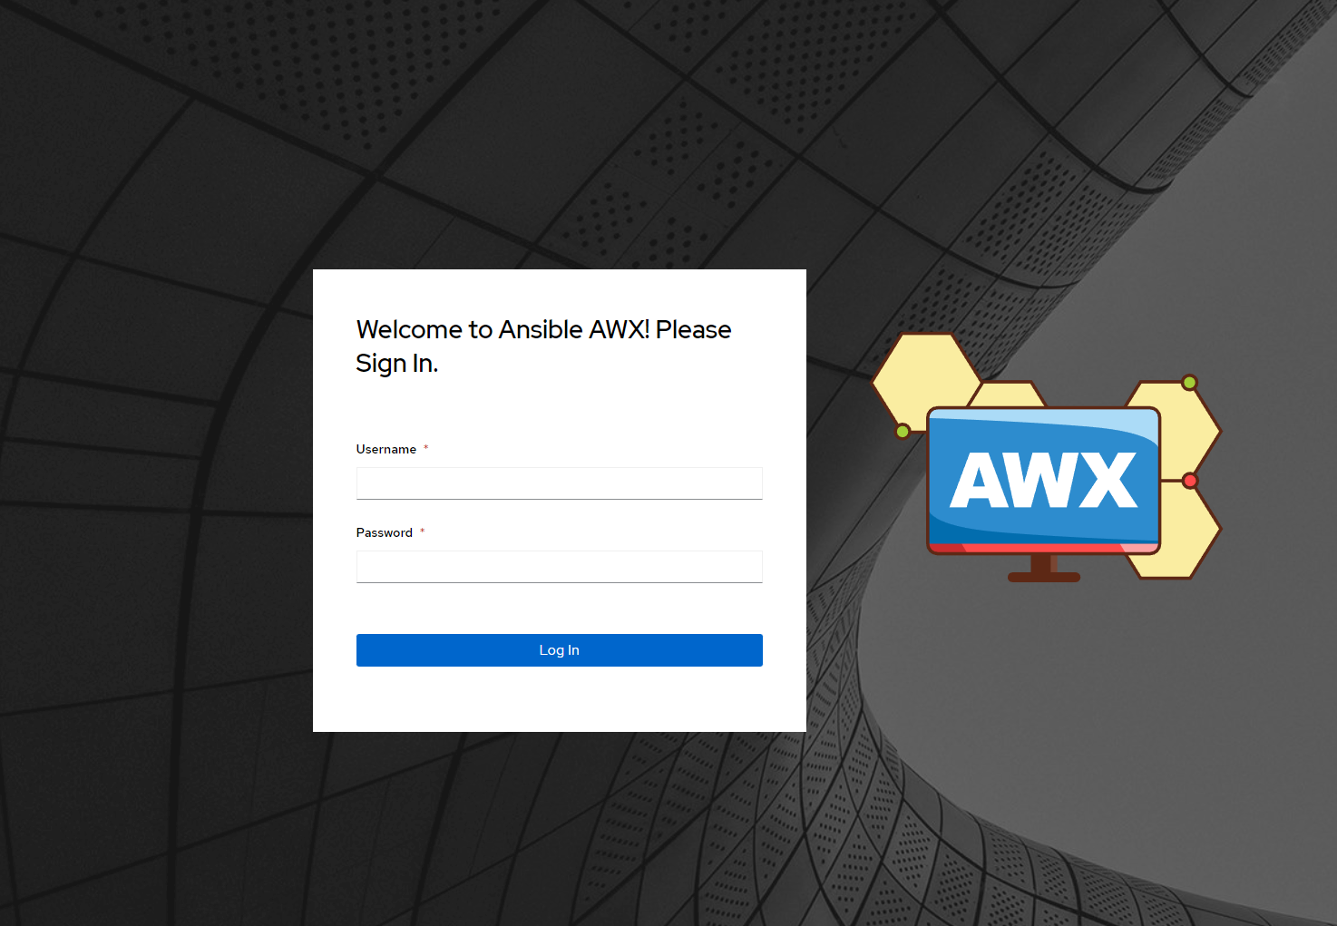
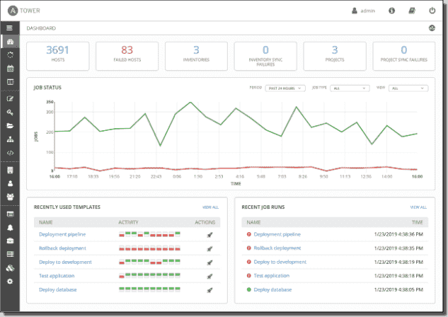
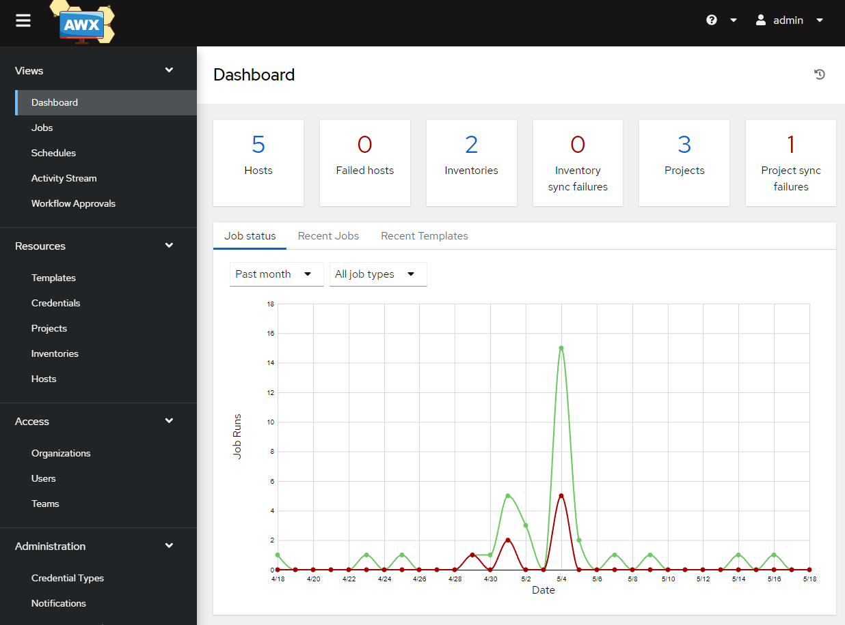
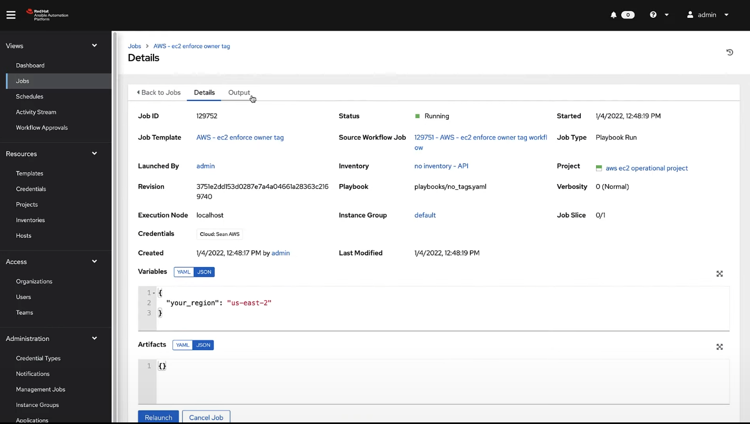
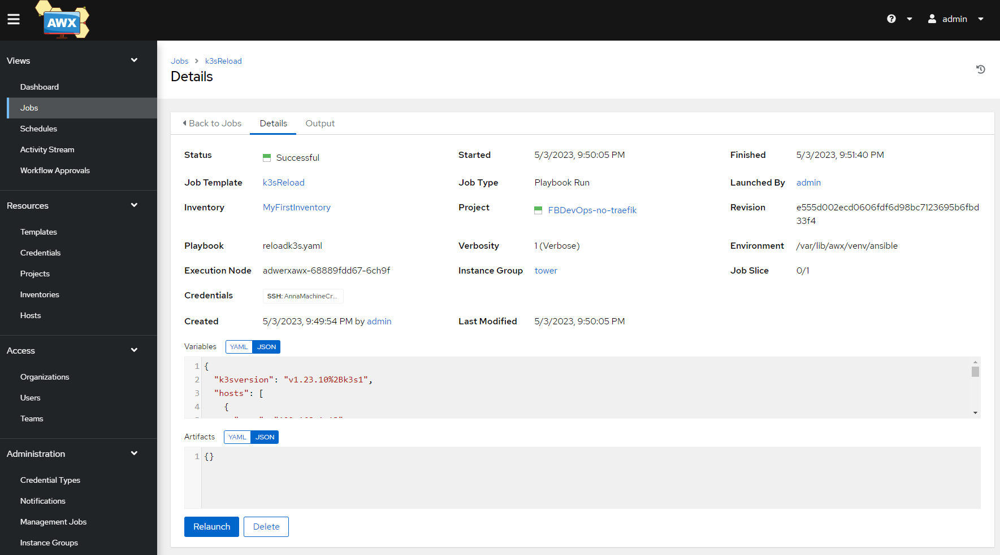
Tower/AAP vs AWX

Slide 37
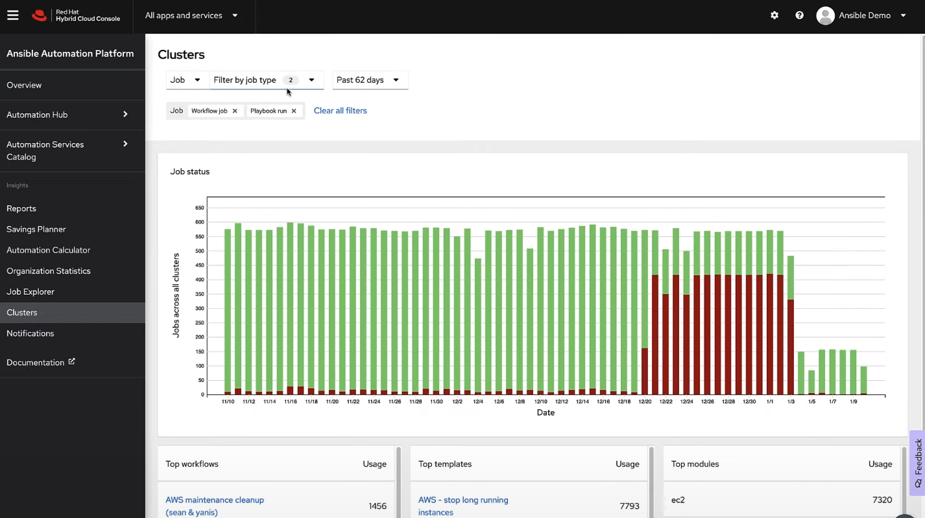
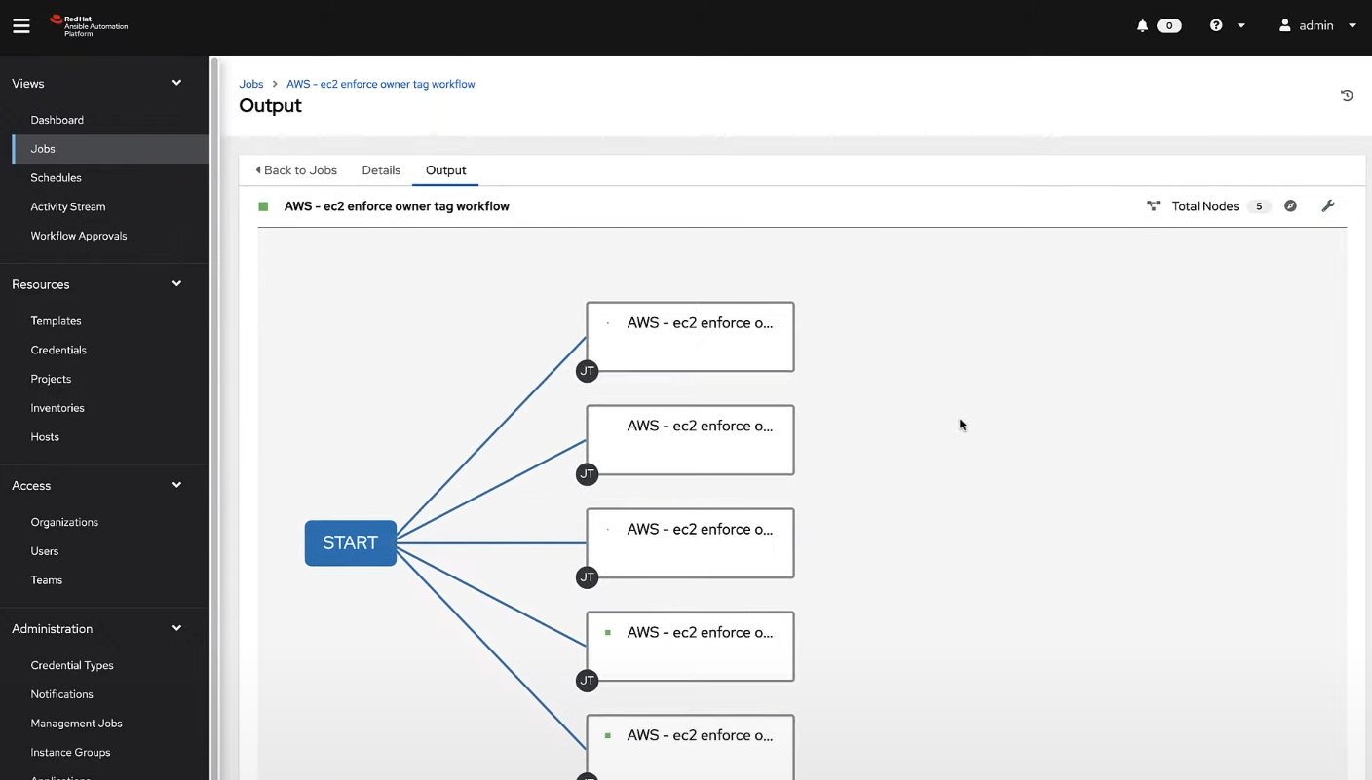
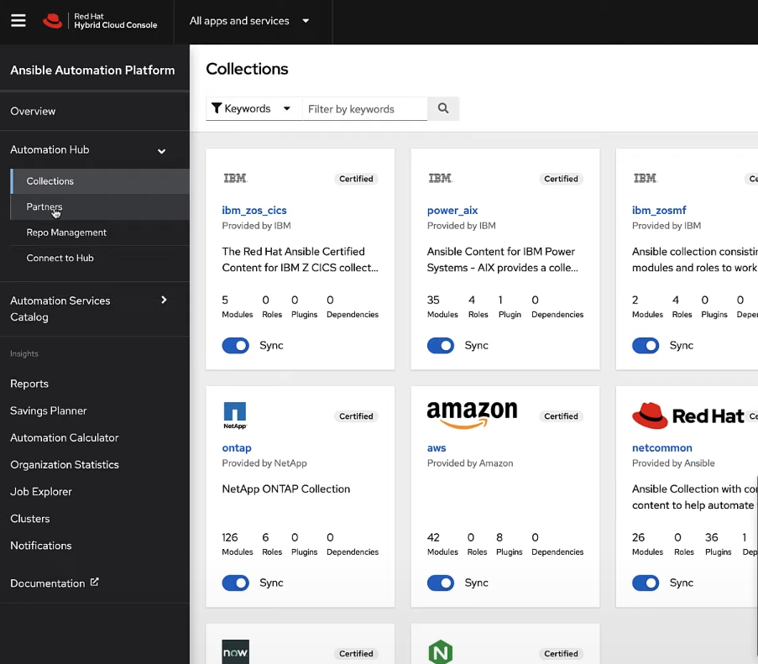
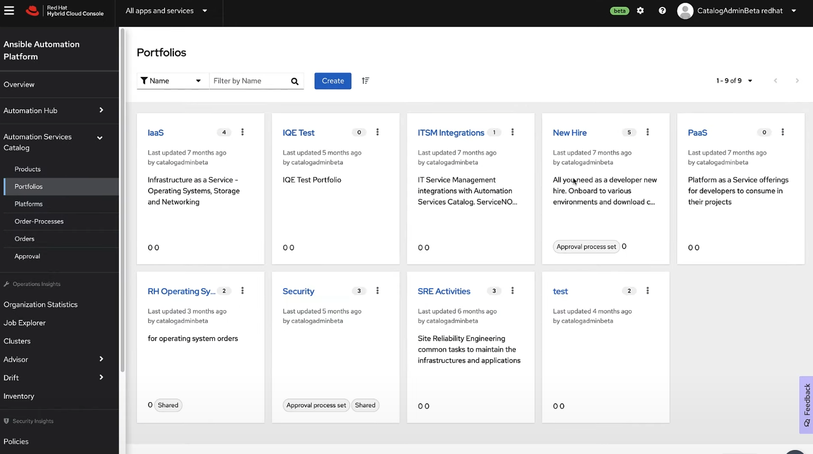
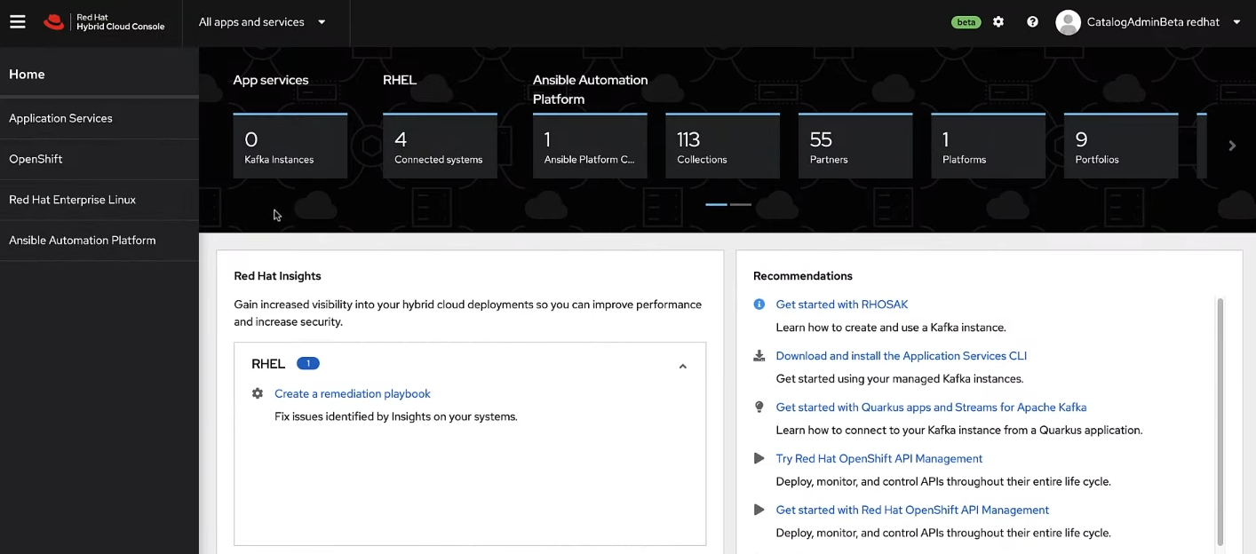
RH Value Adds
Ansible Automation Platform (Commercial) uses the OS Development Model
RH Certified Content with 18mo Support Lifecycle
AAP - Hardened and functional OTB
Notes:
The cross-pollination and feeding with OS group
Cluster Management,
Triggered Jobs
Collections – Certified content with 18mo of Support

Slide 38
Terraform
Best in Class

Slide 39
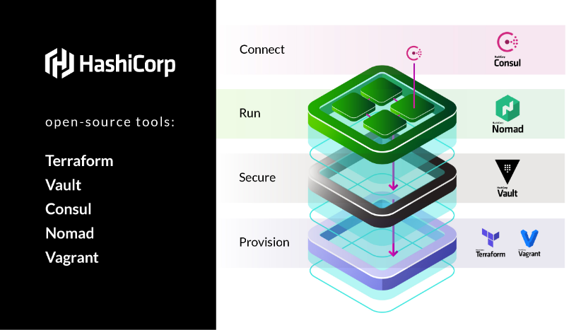
Notes:
And Packer

Slide 40
Terraform
Open-source and active - Free to use in every way
Large active community providing modules
Supports all clouds and many on-prem – F5, VMWare
Supports many other tools – Datadog, NewRelic, etc
Works on most Oses with a simple binary

Slide 41
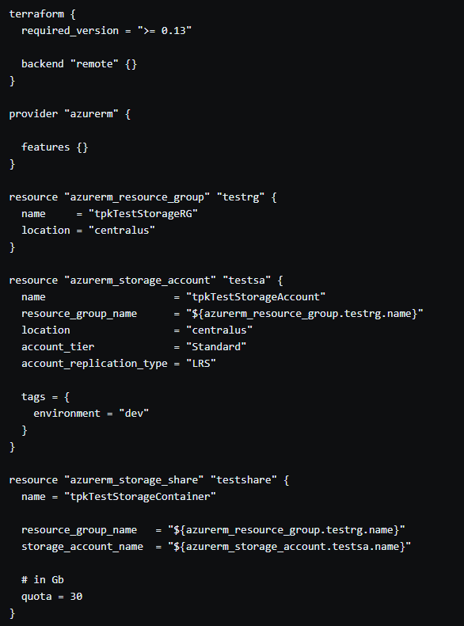
Usage: Example
Create an Azure Resource Group
A Storage account in the Resource Group
A Storage Share with a 30Gb quota

Slide 42
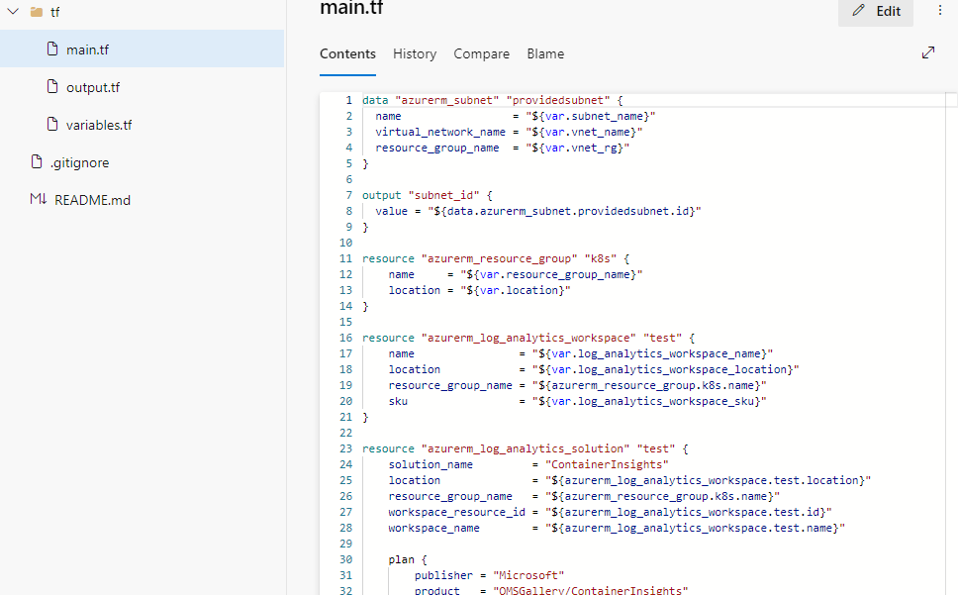
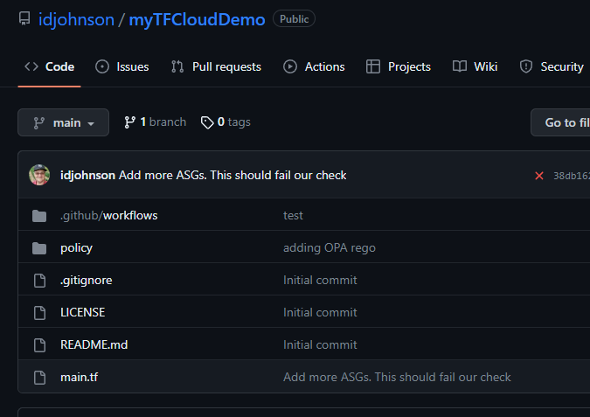
Using AzDO / GH

Slide 43
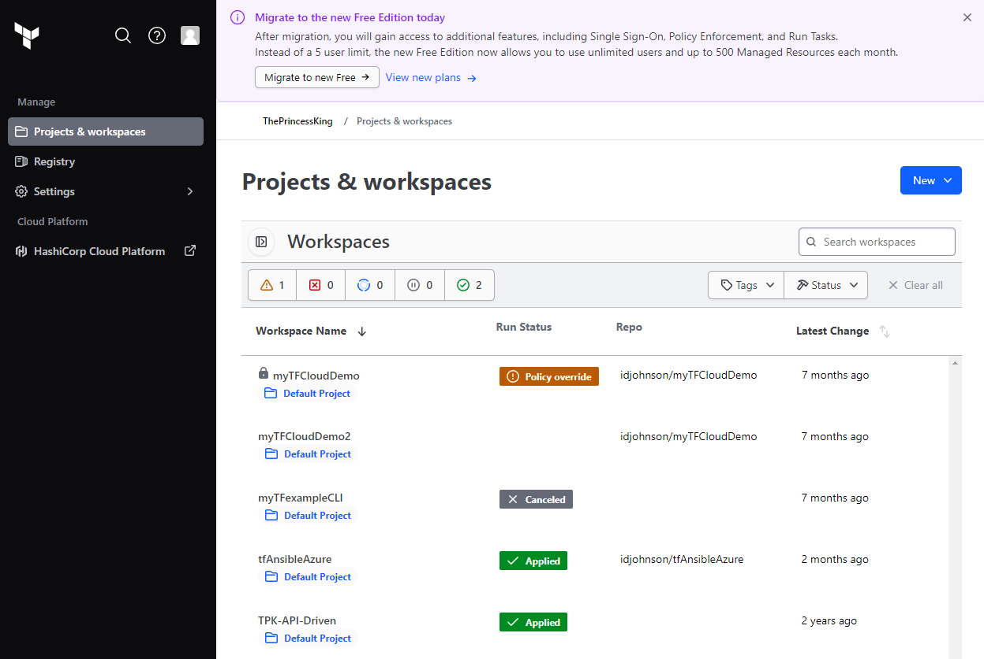
TF Cloud

Slide 44
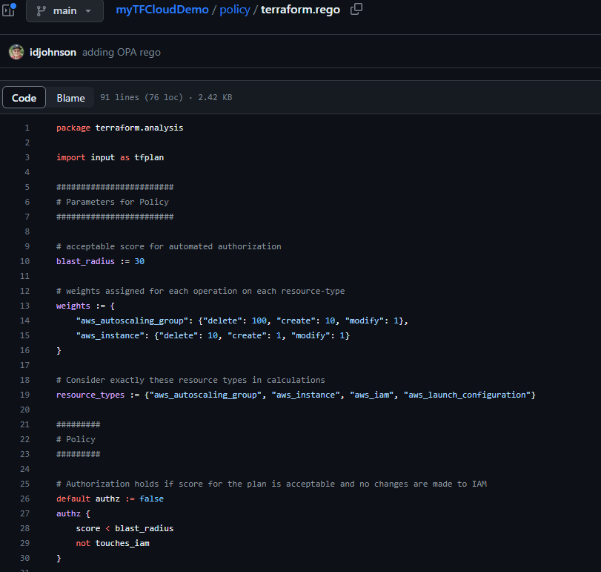
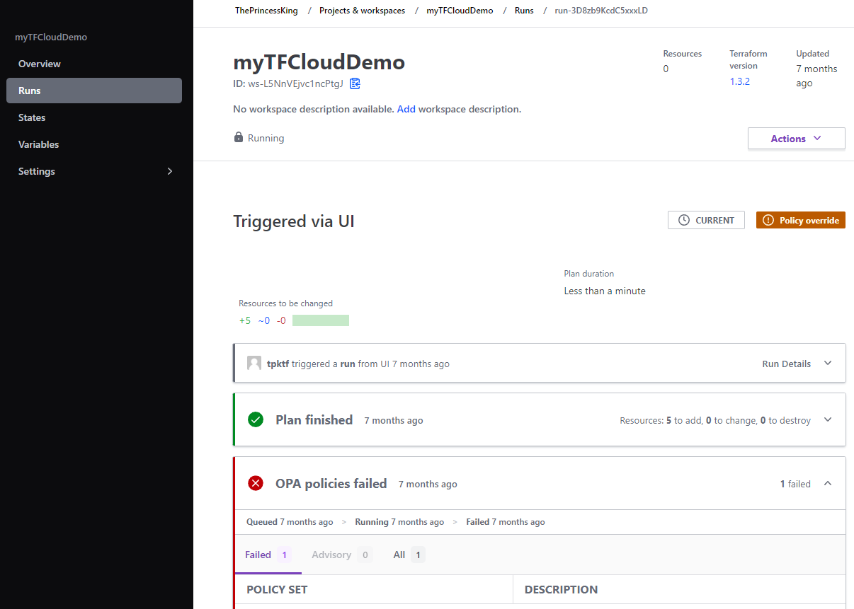
TF Cloud : OPA

Slide 45
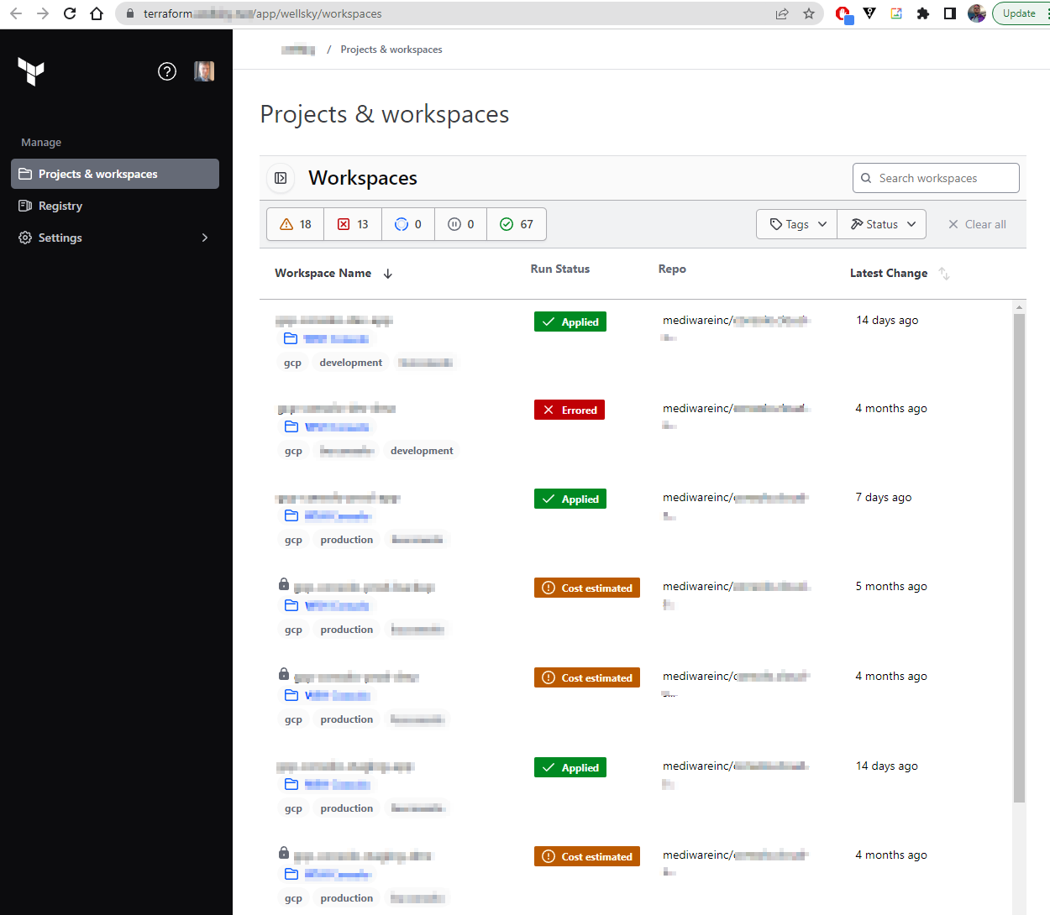
TFE

Slide 46
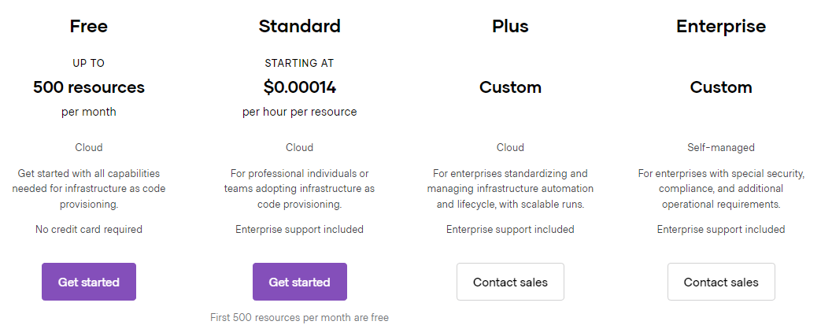
Pricing

Slide 47
02
Minimizing Cloud Costs

Slide 48
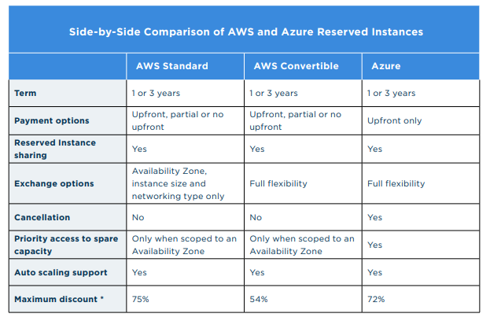
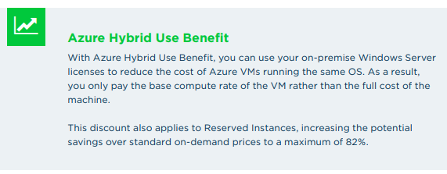
Usage and Up Front Discounts
Azure: Reserved Instances (RI)
25%
Discounted from 1mo to 1year. Pay up front. Can save up to 72% on cost of compute
AWS: Reserved Instace (RI)
Standard and Convertible types as well as “Scheduled”. Pay upfront, partial, or pay as you go.
50%
GCP: Committed Use Discount (CUD)
Can save between 28% to 57% on most VMs. Up to 70% (for Mem Optimized VMs)
GCP: Sustained Usage Discount (SUD)
Automatic 30% savings when running over 75% of time in month. Cannot combine with CUD
Notes:
Azure RI = Reserved Instances
discount monthly or a greater one yearly
Azure Reserved Instances can save you up to 72% on the cost of running your VMs.
AWS RIs =
Standard, Convertible and now Scheduled Ris
Convertible maxes out at 45% savings
Scheduled RIs for 1-y term only - minimum of 1200hrs… few instance families
up front or in installements (more you pay up front, more savings)
For BIG companies
if over $500k in a region, you get a 5% discount
if over $4m in a region, 10%
GCP CUD = Committed Used Discount
1y or 3y
CUDs can actually be MORE expensive than SUD

Slide 49
Comparing Clouds
Notes:
AWS: m5.large 2vCPU 8Gb EBS up to 10Gb , 4,7500 MBbs
Azure: Standard_D2s_v3
GCP n1-standard-2

Slide 50
2CPU 8GB Linux VM by Cloud and Discount
 | AWS: m5.large |  | Azure: Standard Dsv2 D2 | GCP: n1-standard-2 | Akamai/Linode: D4-8G
Monthly (730h) | $70.08 / $80.88 (w/ Disk) |  | $92.71 (incl. 14gb Disk) | $48.54 / $64.54 (w/ Disk) | $48 (incl. 160Gb disk)
1 year | $51.83 (convertible) | $43.80 (only m5) | $80.29 | $69.36 (28% CUD < 30% SUD!!) | $48
3 year | $35.87 | $29.93 | $63.36 | $52.02 ( 46% discount) | $48

Slide 51
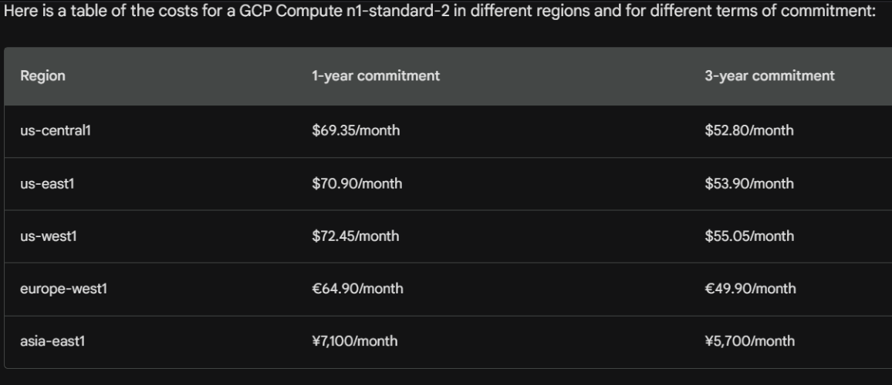
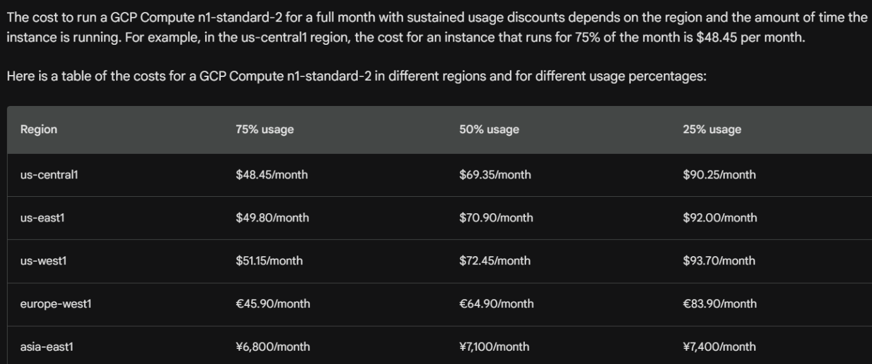
GCP CUDs and SUDs

Slide 52
Free Tier
 | Type | Limits | Time/Instance | Duration
GCP | f1-micro | 30Gb Disk 1Gb Bandwidth 1 vCPU 500Mb Mem | 1 VM | Monthly
AWS | t2micro | 1 vCPU 1 Gb Mem “Low” network perf | 750H | Monthly
Azure | B1 Burstable | 1 vCPU 1 Gb Mem | 750H | Monthly

Slide 53
Demo – Free Tier
Windows or Linux
1 Year Limits

Slide 54
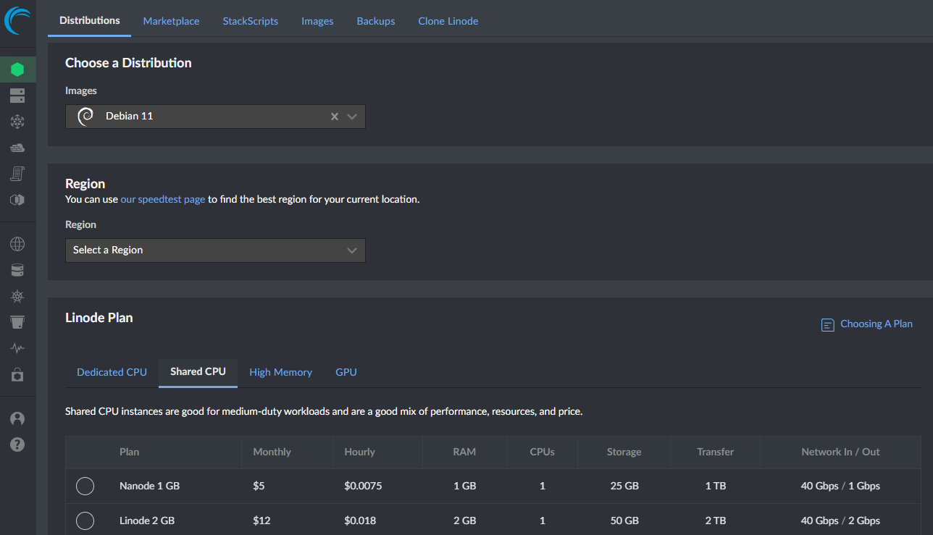
Consider Alternate Clouds

Slide 55
Cloud Provider that Specialize in OS: Aiven.io

Slide 56
Budgets
Costing Alerts from the Cloud

Slide 57
Budget Rules
20%
50%
95%
Notify
Alert
Disable
Notify Parties of Persisting Spend
Alert controlling parties that spending has reached half of budget
Start to disable new workloads to avoid overspend

Slide 58
Budgets

Slide 59
Anomaly Detection

Slide 60
Budgets in Google Cloud

Slide 61
Budgets in Google Cloud

Slide 62
Monitors
Cannot Manage what you don’t Monitor

Slide 63
Cloud Cost Monitoring Options
OpenCost
KubeCost
Cast.ai
Ternary
Forked from KubeCost. Free and OpenSource
Free Community Edition Commercial Offering
Free Plan Commercial Offering
Commercial Offering

Slide 64
OpenCost

Slide 65
OpenCost : API

Slide 66
KubeCost

Slide 67
KubeCost: Kubernetes Rightsizing

Slide 68
KubeCost: Kubernetes Rightsizing and Alerts

Slide 69
Cast.ai

Slide 70
Cast.ai: Forecasting Cost

Slide 71
Cast.ai: Smart Node Pools

Slide 72
Ternary.app

Slide 73
Ternary.app

Slide 74
Mitigation
Terminate and Destroy

Slide 75
Create a Policy
Run Cloud Custodian
Refine and Improve Policies
Define the rules for our environment(s)
Using container, script or service
Update and refine to improve

Slide 76
Policy Example: Force a tag
For All Azure VMSS That match the name ‘azdovmssexample’
Set a Tag “Hello” to value “World”

Slide 77
Results
Notes:
The first VMSS does not match the name, not modified
The second does, and we see the tag was created

Slide 78
Policy Example: Force a tag
For all VMSS that do NOT have the Hello tag
Delete them

Slide 79
Cloud Custodian: Demo

Slide 80
Cloud Custodian : Automating
AzDO
Ansible
Notes:
https://github.com/idjohnson/ansible-playbooks/blob/main/cloudcustodiandocker.yaml
https://github.com/idjohnson/ansible-playbooks/blob/main/cloudcustodian.yaml

Slide 81
VSE (MSDN)
Monthly Credits
$150 / VSE
$100 / MSDN Platforms
$50 / Visual Studio Professional / VS Test Professional
Presently
$6000/new $2569/renew

Slide 82
VSE (MSDN)
When over-spend, systems disabled, nodes powered down
First of month, re-enabled

Slide 83
Temporary/Sandbox accounts
Temporary projects that are deleted.
Used for POCs and Demos

Slide 84
Account Policies
Use Allowed or Not Allowed
Assign to Account or RG
Will block future create and edit

Slide 86
Summary
Open Source Platforms
Cloud Offerings
Linux is Queen. Use Kubernetes.
Keep with Active OS Containers
Think critically of value
Look for free tier
(but do not bank on it)
Consider non big-3 clouds
Open Source Languages
Budgets and Monitors
You can experiment, but stick to GPL and OS Programming Languages
Measure and Report
Use Cloud Budgets for alerting
Use OS tools like OpenCost to monitor
Open Source Provisioning / IaC
Mitigation
Tooling like AWX and Terraform
Look for stable OS platforms with Commercial value-adds and support
Tooling like Cloud Custodian to control costs
Use VSE and Temporary Learning Accounts
Use Policies to Restrict Resources

Slide 87
Thank You!
Recording of this Talk
Do you have any questions?
Isaac@freshbrewed.science
@Ijohnson@noc.social
https://www.linkedin.com/in/isaac-johnson-9b8974/
Freshbrewed.science
Please keep this slide for attribution
Notes:
https://www.facebook.com/nulubez
https://noc.social/@Ijohnson
https://www.linkedin.com/in/isaac-johnson-9b8974/

Slide 89
Using Linux in Windows
WSL in action
Notes:
https://rdodev.medium.com/saved-you-an-analyst-read-on-kubernetes-growth-2018-edition-810367876981
https://percona.community/blog/2019/07/08/tame-kubernetes-with-open-source-tools/

